Slide 1
Edoardo Marcucci & VALERIO GATTA University of Roma Tre & Molde UniversiTy College
6th Meeting on international Economics
Freight transport in Europe: facts and figureS
Institute of International Economics – University Jaume I of CastellÓn, Sept. 27-29, 2017
Innovative urban freight tansport:
solutions in the sharing & circular economy era

Slide 2
Index
Introduction
Integrating direct and reverse logistics (CITYLAB)
Crowdshipping and its integration with Physical Internet
Ecolabeling for logistics
Gamification
Participatory UFT planning
Conclusions

Slide 3
Introduction
Reuse
Share
Buy responsively
Reduce waste
Recycle
Circular economy

Slide 4
Integrating direct and reverse logistics (CITYLAB)
DIRECT LOGISTICS
REVERSE LOGISTICS

Slide 5
Same truck!!!

Slide 6
Physical Internet
Transform the way physical objects are handled, moved, stored, realized, supplied and used (Montreuil & Benoit, 2012).
Encapsulation of goods in smart, ecofriendly and modular containers π-container, hubs, distribution centers, vehicles… (Modulushca).

Slide 7
Crowdshipping and its integration with Physical Internet
Physical Internet:
City Logistics:
Interconnected city logistics
City logistics provides the final and last segments of PI-enabled interconnected logistics and transportation networks
concept
assessment
solutions
validation
Physical level
Operationa level
Eg. crowdshipping

Slide 8
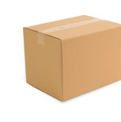
Crowdshipping and its integration with Physical Internet
Marco decides to accept.
A
B
Ramon has to go from A to B.
An online platform informs him about a package to be delivered along the same way (C).
C
As a reward for the deviation he gets a refund.

Slide 9
Ecolabeling for logistics
Which one would you choose?
certified product
fair production
environmentally friendly transport
?
lower price, but no guaranties about the impact (Env. Social, etc.) of production and/or transportation service

Slide 10
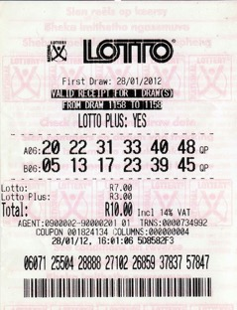
Gamification
Gamification= use of game design elements in nongame contexts (e.g. eco-driving)
Gamification needs to be tailored according to people’s preferences→ SCEs

Slide 11
Participatory UFT planning
Integrated modelling approach:
“Stakeholder behavioural analysis contributes to the ex-ante policy assessment needed to support policy-makers”.

Slide 12
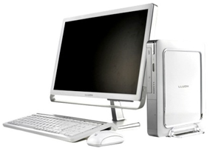
Conclusions
Integrate
Stimulate
Facilitate
Cooperate

Slide 13
Muchas gracias por su atención!

