Slide 1
A research agenda for dealing with current shipping industry challenges facing European seaports
Dr Jason Monios 27 September 2017

Slide 2
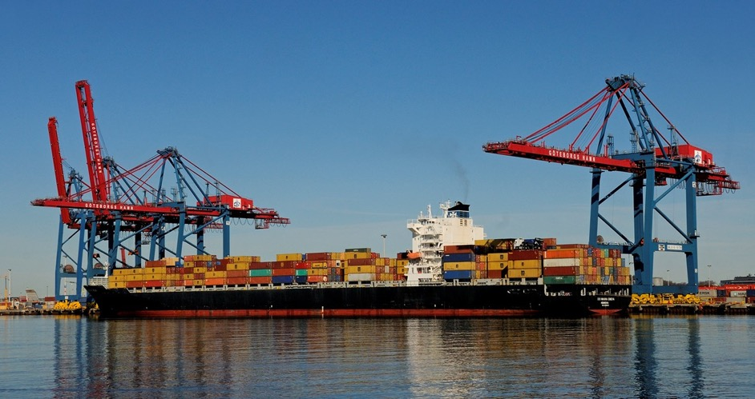
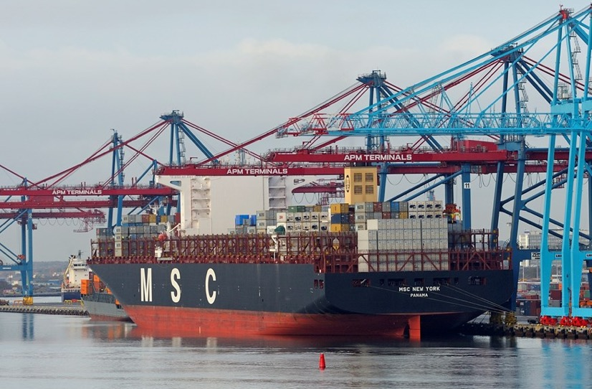
overview
Introduction
Overcapacity
Megaships
Oligopoly
Environment
Other challenges
Research agenda
Images: Port of Gothenburg

Slide 3
introduction

Slide 4
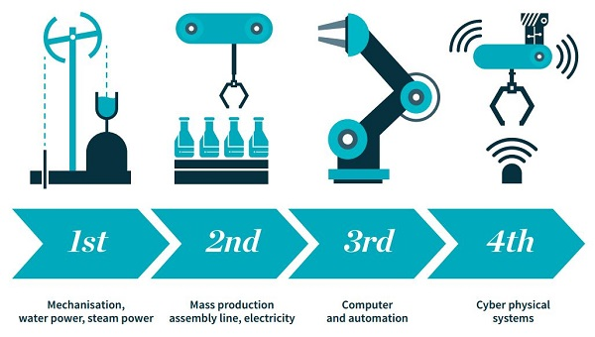
Fourth industrial revolution?
https://www.sheffield.ac.uk/news/nr/science-and-innovation-audit-fourth-industrial-revolution-1.659628
https://www.weforum.org/about/the-fourth-industrial-revolution-by-klaus-schwab
More than just technology and digitalisation but bringing together the physical, digital and biological.
Relevant to ports?

Slide 5
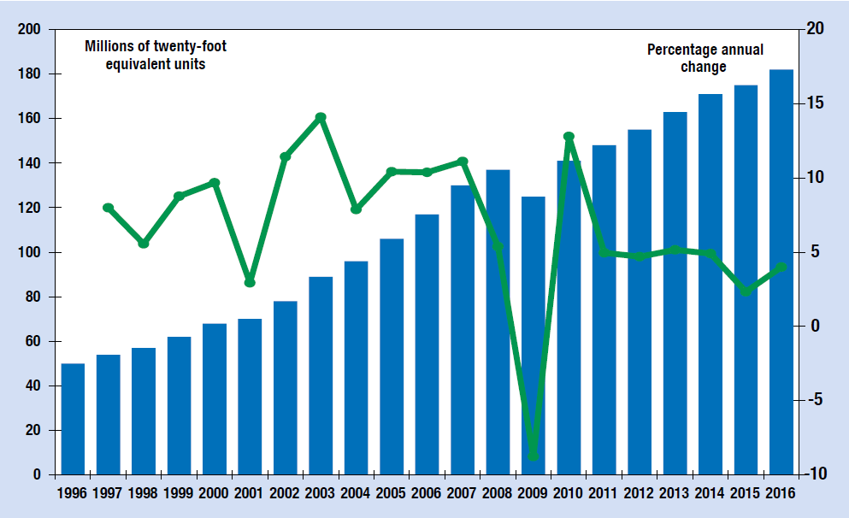
World port traffic
UNCTAD 2016
Slow growth since 2008 – the new normal?

Slide 6
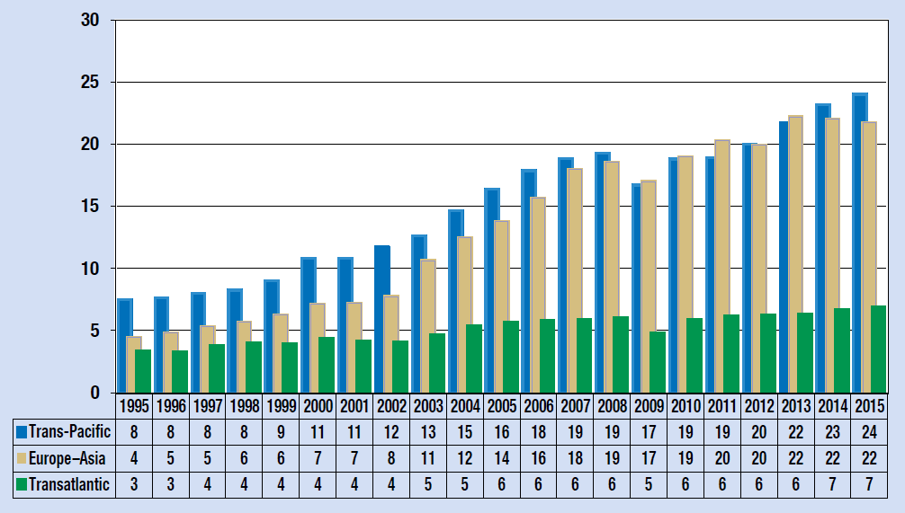
Asia-Europe port traffic
Stagnation since 2013 – the new normal?
UNCTAD 2016

Slide 7
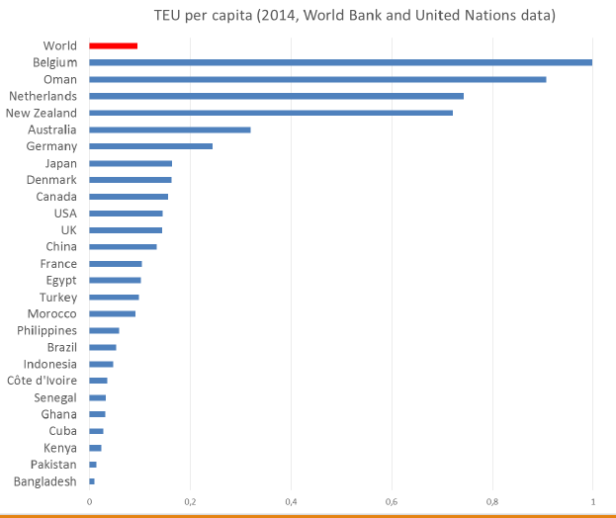
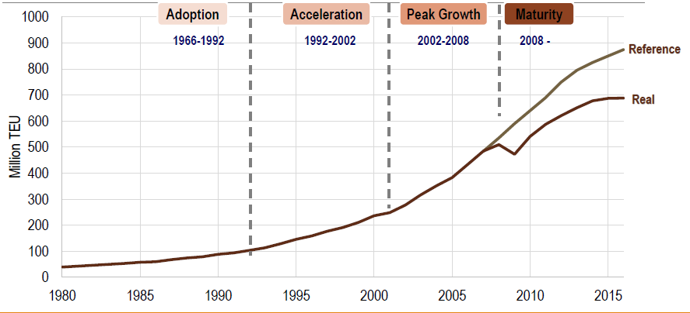
Peak containerisation?
xxx

Slide 8
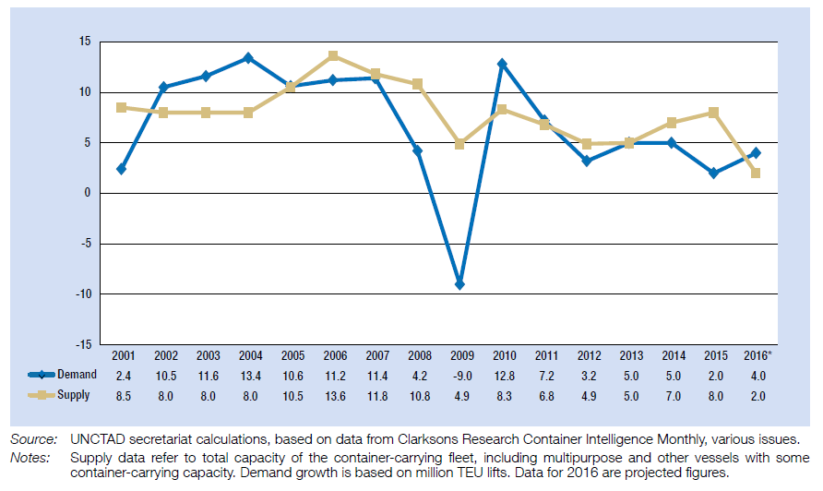
Demand and supply
UNCTAD 2016

Slide 9
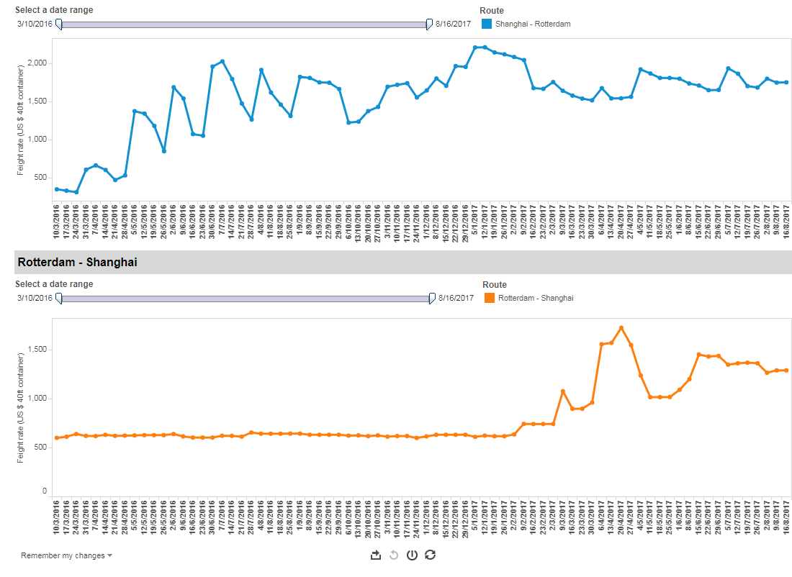
freight rates have picked up
https://lloydslist.maritimeintelligence.informa.com/markets/containers/data-hub/world-container-index
Drewry index
16th Aug 2017
$1,754 SHA-ROT

Slide 10
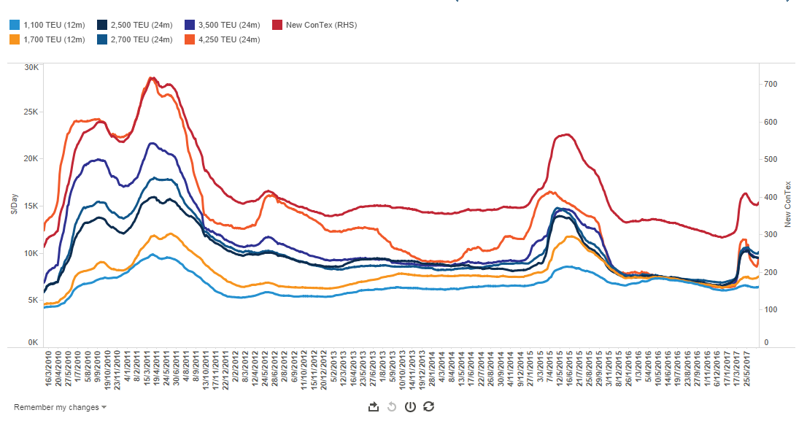
charter rates not so much
https://lloydslist.maritimeintelligence.informa.com/markets/containers/data-hub/new-contex
Hamburg Ship Brokers’ Assoc.

Slide 11
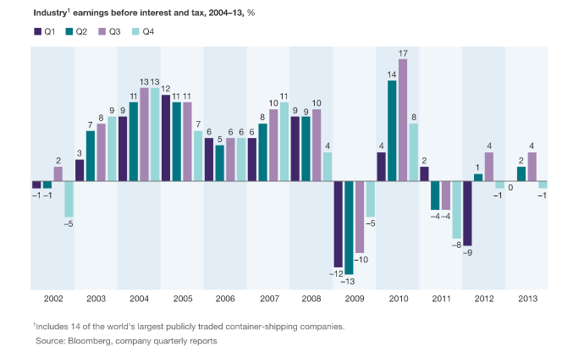
But still a volatile market
Glave et al. (2014). http://www.mckinsey.com/business-functions/strategy-and-corporate-finance/our-insights/the-hidden-opportunity-in-container-shipping

Slide 12
Eu port policy
EU: over 1,200 commercial ports, 70,000 km of coastline, 329 ports in the TEN-T, 104 in the core network.
2014: 3.8 billion tonnes of cargo, 400 million passengers.
EU port policy 2013, regulation legislation Feb 2017
Improve connections to network
Modernise
Attract investment
Environmental directives
State aid update
Transparency in funding

Slide 13
overcapacity

Slide 14
Capacity and trade
OECD (2015)

Slide 15
Total World fleet and order book
TEU range | In service April 2017 |  | On order 2017 |  | On order 2018+ |  | Total vessels on order | Total TEU on order | % of total fleet
 | No. | TEU | No. | TEU | No. | TEU
0-499 | 328 | 86,119 | 6 | 1,238 | 0 | 0 | 6 | 1,238 | 1.4
500-999 | 680 | 516,867 | 4 | 3,241 | 1 | 959 | 5 | 4,200 | 0.8
1,000-2,999 | 1,830 | 3,276,737 | 94 | 182,088 | 109 | 22,1859 | 204 | 406,186 | 12.4
3,000-4,999 | 821 | 3,388,302 | 11 | 41,000 | 27 | 94,720 | 38 | 135,720 | 4.0
5,000-7,499 | 588 | 3,563,363 | 7 | 39,900 | 3 | 15,900 | 10 | 55,800 | 1.6
7,500-9,999 | 454 | 3,962,459 | 10 | 92,200 | 2 | 17,600 | 12 | 109,800 | 2.8
10,000-12,999 | 121 | 1,296,409 | 18 | 198,220 | 20 | 233,200 | 38 | 431,420 | 33.3
13,000-15,999 | 193 | 2,632,460 | 23 | 324,110 | 42 | 594,750 | 65 | 918,860 | 34.9
16,000+ | 68 | 1,261,927 | 20 | 410,350 | 34 | 687,340 | 54 | 1,097,690 | 87.0
Total | 5,083 | 19,984,643 | 193 | 1,292,347 | 238 | 1,866,328 | 432 | 3,160,914 | 15.8

Slide 16
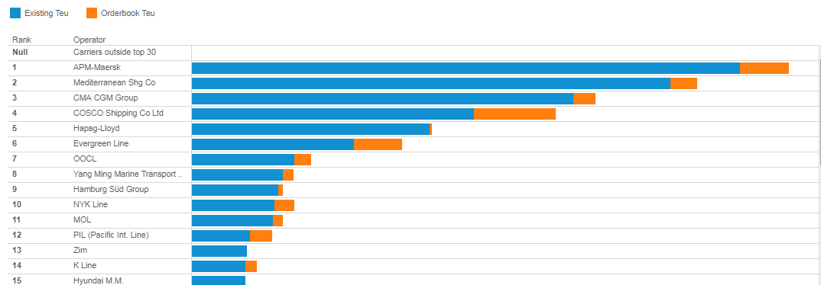
World fleet 1st august 2017
https://lloydslist.maritimeintelligence.informa.com/markets/containers/data-hub/operating-fleet
xxx

Slide 17
Idle fleet
TEU range | Owner operator |  | Chartered/ unknown |  | Total |  | % of total fleet
 | No. | TEU | No. | TEU | No. | TEU
0-499 | 14 | 4,649 | 98 | 22,147 | 112 | 26,796 | 31.1
500-999 | 12 | 7,536 | 51 | 36,188 | 63 | 43,724 | 8.5
1,000-2,999 | 11 | 17,205 | 37 | 64,450 | 48 | 81,655 | 2.5
3,000-4,999 | 0 | 0 | 37 | 150,281 | 37 | 150,281 | 4.4
5,000-7,499 | 1 | 5,714 | 16 | 90,038 | 17 | 95,752 | 2.7
7,500-9,999 | 0 | 0 | 3 | 28,494 | 3 | 28,494 | 0.7
10,000-12,999 | 0 | 0 | 0 | 0 | 0 | 0 | 0.0
13,000-15,999 | 0 | 0 | 0 | 0 | 0 | 0 | 0.0
16,000+ | 0 | 0 | 0 | 0 | 0 | 0 | 0.0
Total | 38 | 35,104 | 242 | 391,598 | 280 | 426,702 | 2.1

Slide 18
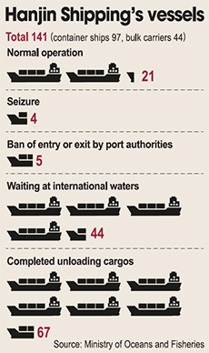
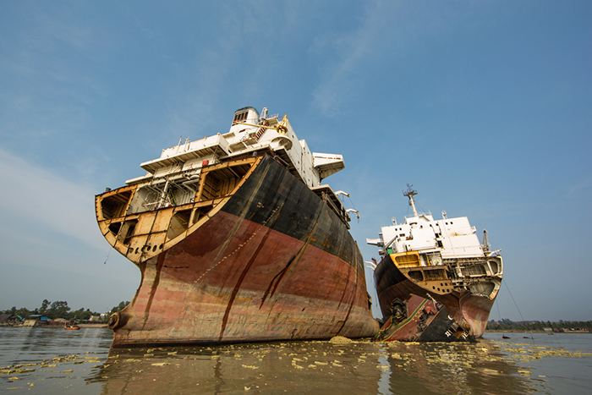
Future?
http://www.koreatimes.co.kr/www/news/biz/2016/09/488_214473.html
More bankruptcies e.g. Hanjin
More scrappings
https://www.joc.com/maritime-news/ships-shipbuilding/rickmers-maritime-scrap-youngest-container-ship-ever_20161212.html

Slide 19
Megaships

Slide 20
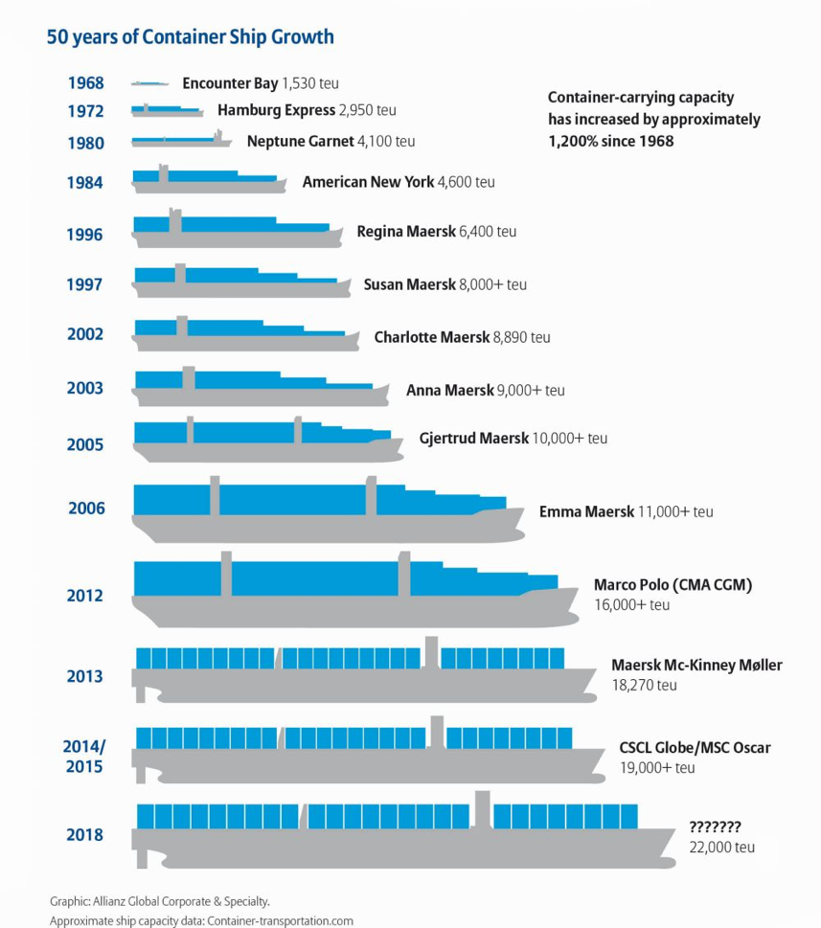
Increase in largest vessel
http://www.agcs.allianz.com/assets/Infographics/ContainerShipGrowthInfographic2015_1000X1125.jpg
OOCL has the world’s largest container vessels – the 21,413 teu OOCL Hong Kong and OOCL Germany
August 2017: CMA CGM in discussions for 6+3 vessels of around 22,000 TEU, around USD150m each

Slide 21
Increase in largest vessel
OECD (2015)

Slide 22
Why megaships?
Asia-Europe ok but leads to cascading
On cascaded routes, little correlation between vessel size and either total route demand or drops per port call.
Hub-to-hub but what about spokes?
Opportunities for other ports to undercut and develop secondary networks?

Slide 23
Vessel cascading
One of the main strategies of shipping lines to cope with oversupply on main routes is to shift vessels to secondary markets. This shift is disconnected from demand growth on these secondary routes.
Wilmsmeier and Monios (2018).

Slide 24
Diseconomies of scale in ports
A 19,000 TEU vessel dropping 8,800 TEU in a single call will necessitate 14,000 container moves, six 800 TEU feeders, 53 trains (carrying 90 containers each), three 96 TEU barges and 2,640 trucks (Grey, 2015).
Shipping lines already cannot meet their own schedules; current average reliability across the industry is below 70%. The larger the vessel and the larger the drop of containers at each call, the larger the knock-on effect of such poor reliability on the rest of the container system.

Slide 25
Diseconomies of scale in ports
Haralambides, 2016

Slide 26
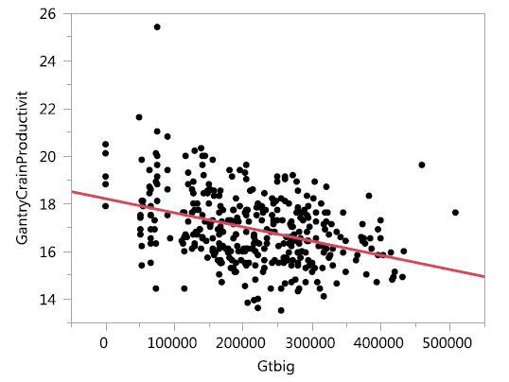
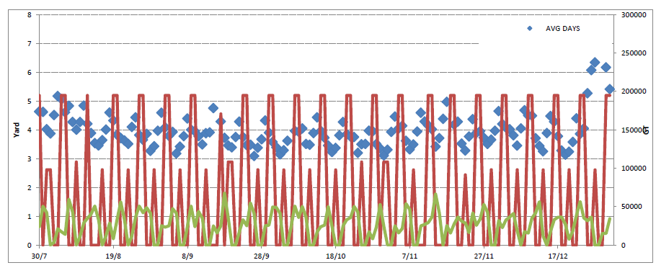
Diseconomies of scale in ports
Crane productivity goes down
Dwell time goes up
OECD, 2015

Slide 27
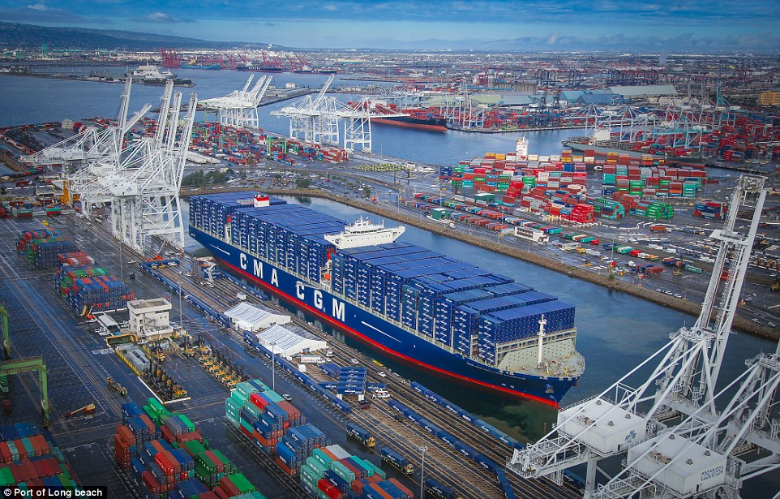
Must ports obey?
https://www.cma-cgm.com/news/1069/the-cma-cgm-benjamin-franklin-the-largest-vessel-ever-to-call-the-united-states-will-be-inaugurated-in-long-beach-today
Bird (1963; p.33): “The ship designer has always been the pacemaker in shipping transport innovations since his creation has merely to float and sail economically per ton mile; whereas the port engineer has to cope not only with
the demands of ship designers, but also with the physical difficulties of the port’s land and water sites.”

Slide 28
oligopoly

Slide 29
Market share of carriers
Wilmsmeier et al. (2018).

Slide 30
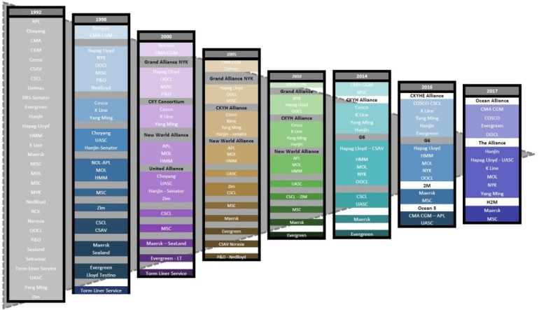
alliances
Sánchez & Mouftier (2017). http://www.porteconomics.eu/2017/04/20/the-puzzle-of-shipping-alliances-in-july-2016/

Slide 31
Global containership fleet growth vs throughput growth
Wilmsmeier et al. (2018).

Slide 32
Mergers and alliances
2016: big mergers: Cosco/China Shipping, CMA CGM/NOL, Hapag Lloyd/UASC, Maersk/Hamburg Sud, K-Line, MOL and NYK Line
Three big alliances: 2M, Ocean Alliance and The Alliance.
Drivers for increased efficiency or market power to force others out of the market?
P3, 2M – need for regulation?
What is the point of deregulation if it leads to monopoly (same as passenger transport)
Liners are seeking more market share as a survival strategy. Is this good for the market and the customer?

Slide 33
European shippers council
“It was presented as a way to improve the quality of services but it has not — the number of ports called has decreased, lead times have increased.”
“We, as ESC, are constantly monitoring the market and we will be able to see what is the real impact of this second round of consolidation. This will give us lots of valuable information for the revision of the European Commission’s Block Exemption Regulation [BER] or any other competition topic.”
August 2017

Slide 34
environment

Slide 35
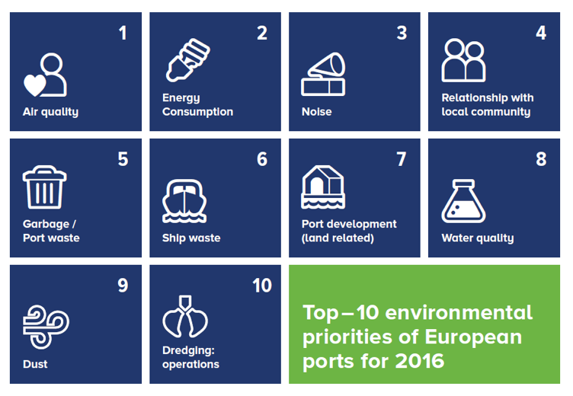
Espo environmental priorities
Air quality
Energy consumption
Noise
Relationship with local community
Garbage/ port waste
Ship waste
Port development
Water quality
Dust
Dredging operations
http://www.espo.be/news/espo-reveals-new-top-10-environmental-priorities-o

Slide 36
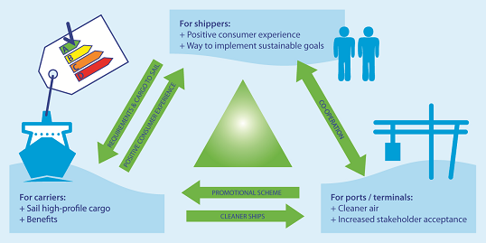
Green ports?
Lots of branding but is it greenwash?
https://www.lagersmit.com/wp-content/uploads/2015/08/ESI.png

Slide 37
EU Directive 2014/94
Member States ‘’shall ensure, through their national policy frameworks, that an appropriate number of refuelling points for LNG are put in place at maritime ports to enable LNG inland waterway vessels or sea-going ships to circulate throughout the TEN-T Core Network by 31 December 2025 at the latest.”
Member States “shall ensure that the need for shore-side electricity supply for inland waterway vessels and seagoing ships in maritime and inland ports is assessed in their national policy frameworks. Such shore-side electricity supply shall be installed as a priority in ports of the TEN-T Core Network, and in other ports, by 31 December 2025, unless there is no demand and the costs are disproportionate to the benefits, including environmental benefits.”

Slide 38
Regulation (EU) 2015/757
MRV: Monitoring, reporting and verification of CO₂.
1st Jan 2018
Large ships over 5,000 gross tonnes calling at EU maritime ports must monitor and report their CO₂ emissions in accordance with their monitoring plan.
https://ec.europa.eu/clima/policies/transport/shipping_en#tab-0-3
It is the first step towards integrating shipping emissions into EU emissions policy and then setting reduction targets.

Slide 39
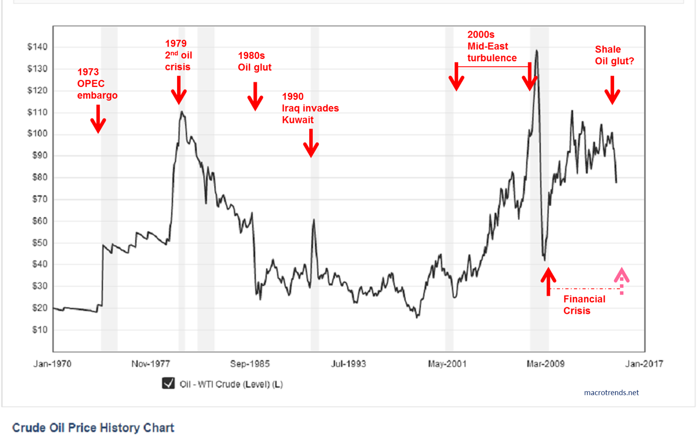
Oil price
https://ktwop.com/tag/oil-price/
No problems anymore? What about peak oil?

Slide 40
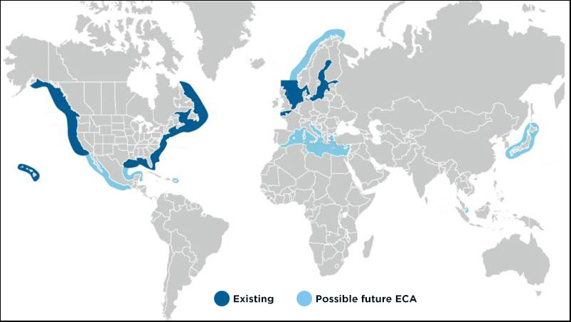
SECA – so what?
http://meproduction.dk/emission-standarts/emission-control-areas/

Slide 41
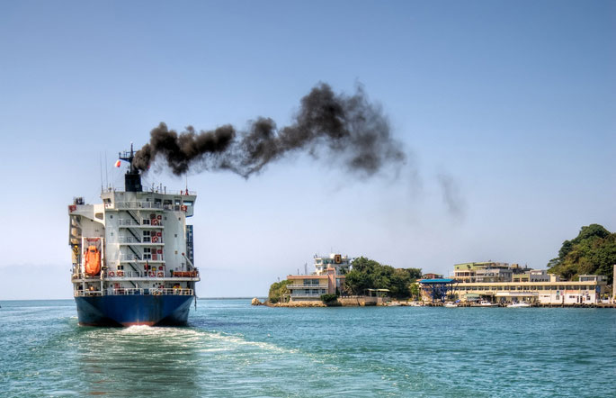
HFO
Shipping produces 2.8% of global GHG emissions, double that of air travel
http://worldmaritimenews.com/archives/217140/imo-urged-to-ban-heavy-fuel-oil-in-arctic-waters/
http://www.pixelboyz.com/piho/heavy-fuel-oil-price-1673.php

Slide 42
Stronger lead needed from imo?
SECA = 0.1% sulphur
0.5% sulphur cap on marine fuel from 2020 imposed by the IMO (HFO = 3.5%)
EU: 0.1% sulphur limits while at EU ports
Some NOx limits on certain vessels
Energy Efficiency Design Index (EEDI) requires a minimum energy efficiency level per capacity mile: certain new ships must adhere
Ship Energy Efficiency Management Plan (SEEMP) requires that shipping companies aim to improve the operational efficiency of vessels: all new ships must adhere

Slide 43
Environmental ship index ESI
ESI SCORE = ESI NOX + ESI SOX + ESI CO2 + OPS (max. 100)
http://www.environmentalshipindex.org/Public/Home/ESIFormulas
Port of Marseille recently joined the World Ports Climate Initiative (WPCI). From 1st July 2017 giving discounts in port dues for vessels with an ESI score above 35. Around 50 ports worldwide have joined.

Slide 44
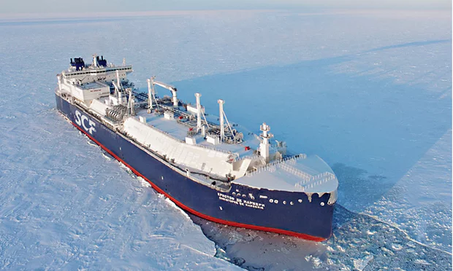
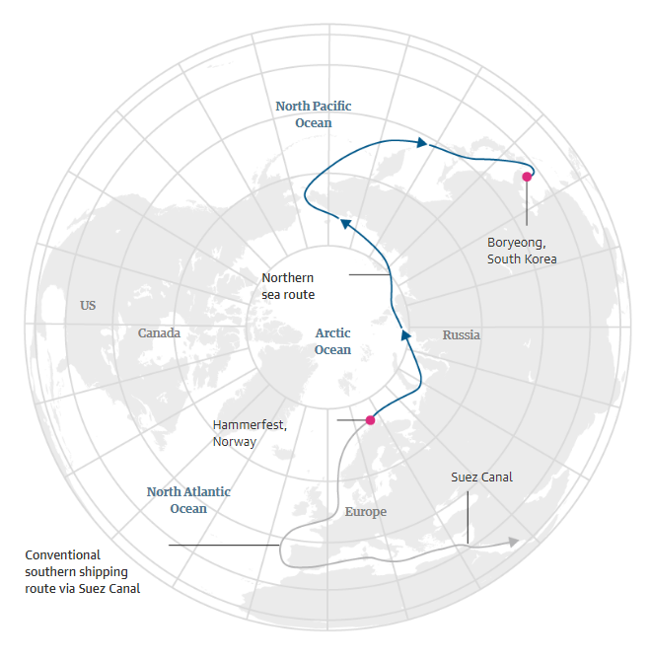
Arctic sea route
The Guardian 24th Aug. 2017. https://www.theguardian.com/environment/2017/aug/24/russian-tanker-sails-arctic-without-icebreaker-first-time
Christophe de Margerie carried a cargo of LNG from Hammerfest in Norway to Boryeong in South Korea in 19 days, about 30% quicker than the conventional southern shipping route through the Suez Canal.

Slide 45
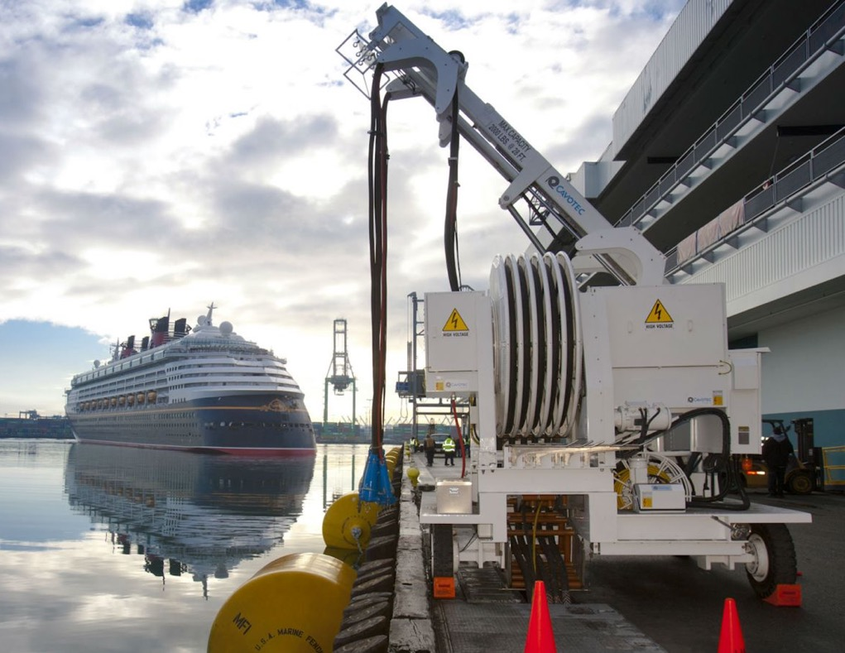
cold ironing
Slow takeup
Mostly large ports
EU policy
http://maritime-executive.com/features/is-cold-ironing-redundant-now

Slide 46
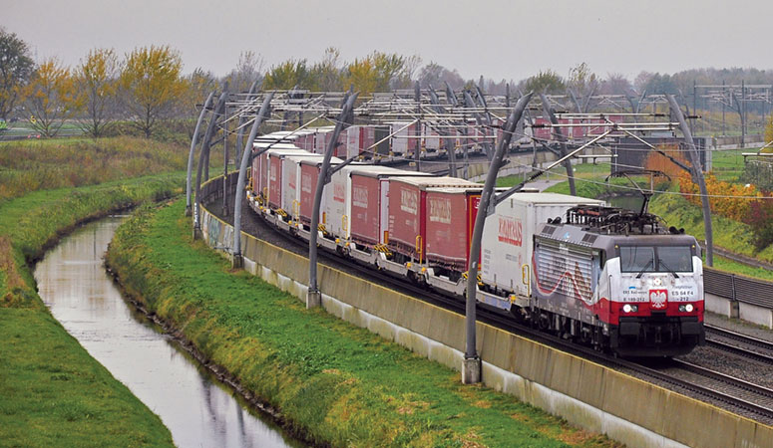
Modal shift - intermodal
Considerable success in recent decades
Shorter distances still challenging
Some way off meeting EU modal shift goals
Role of TEN-T
http://www.gww-bouw.nl/forse-vertraging-duitse-deel-betuweroute/

Slide 47
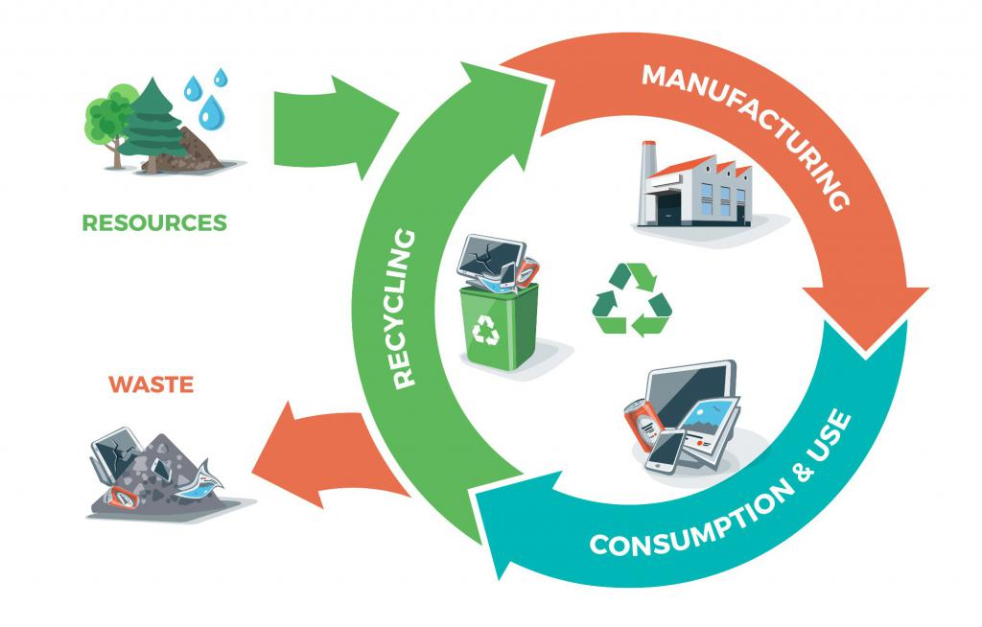
Circular economy
“Maintaining the value of materials and resources as long as possible in the economy and by increasing resource efficiency, recycling and reuse, as well as reducing landfilling. This transition creates local jobs, growth, and opportunities for social integration while enhancing competitiveness. It also helps achieve EU objectives on climate and energy and support its commitments on sustainability.”
https://ec.europa.eu/jrc/en/news/research-helps-europe-advance-towards-circular-economy

Slide 48
other challenges

Slide 49
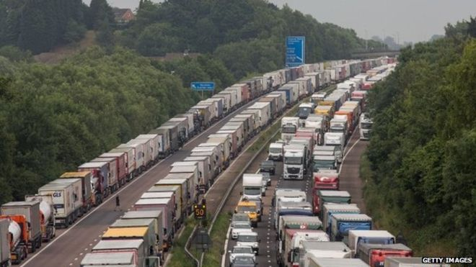
brexit
Impact on ports of leaving the customs union . . .
http://www.bbc.co.uk/news/uk-england-kent-33415361

Slide 50
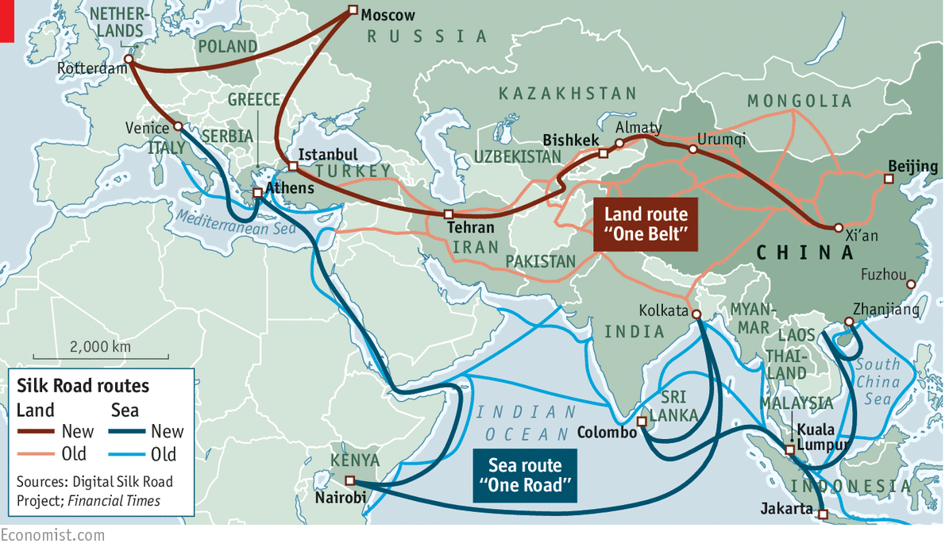
China
https://www.economist.com/news/china/21701505-chinas-foreign-policy-could-reshape-good-part-world-economy-our-bulldozers-our-rules
Economy slowdown?
Focus in internal trade rather than exports?
OBOR
Investing in European ports: COSCO Piraeus & 51% share in Noatum
Overland rail vs shipping?

Slide 51
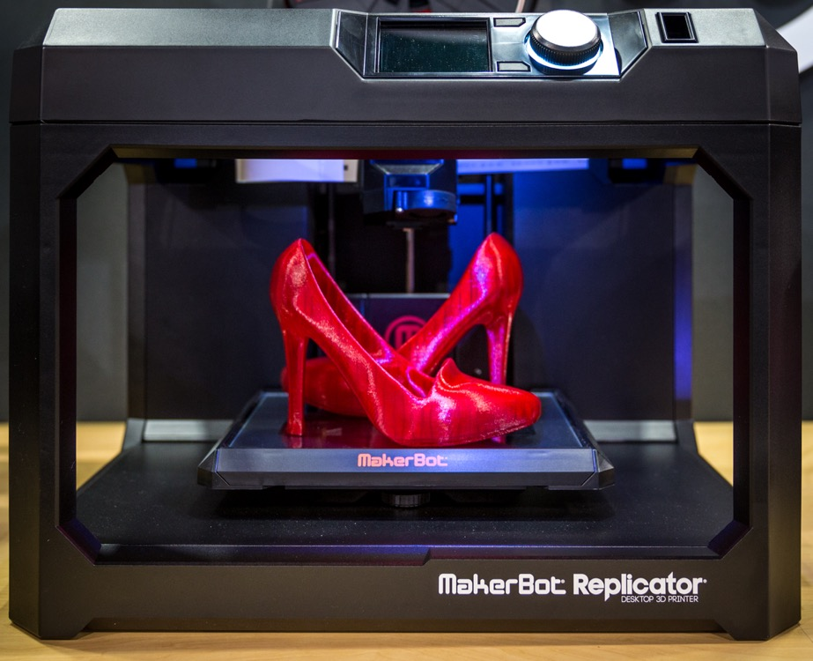
New industry trends
3D printing
Reshoring
More south-south and intra-regional trade?
Amazon becoming a freight forwarder
http://blog.inkjetwholesale.com.au/featured/comprehensive-guide-3d-printing-3d-printers/

Slide 52
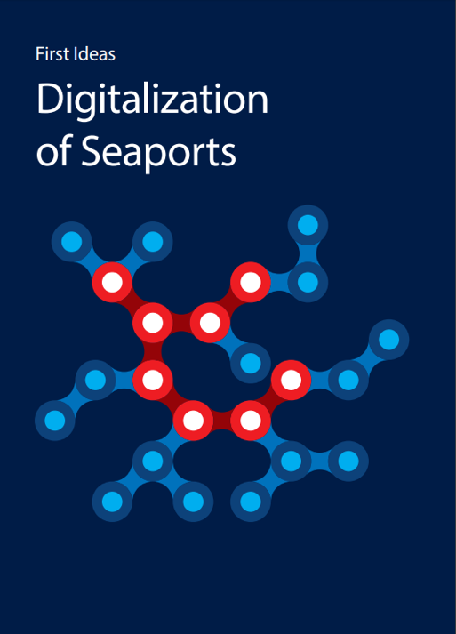
iCt & digitisation
Knowledge sharing (e.g. match truck arrivals with container availability)
Linking inland transport with port arrivals/departures
Track and trace
Increased automation in port operations
Single window customs
More efficient or more risky?
http://www.globalmaritimehub.com/reports-presentations/digitalisation-of-seaports.html

Slide 53
Cyber attacks
http://www.valourconsultancy.com/maersk-cyber-attack-lesson-learned/
APM terminals 27th June 2017.
17 terminals hit by ransomware attack.
Cost USD200-300m

Slide 54
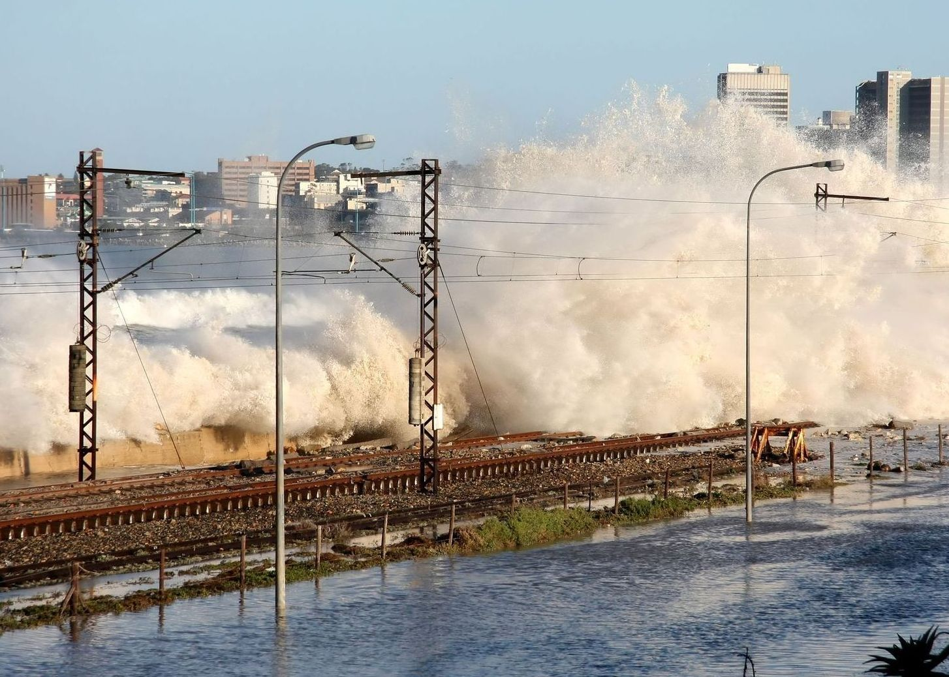
Climate change adaptation
http://www.portstrategy.com/news101/port-operations/planning-and-design/a-question-of-magnitude
Storm surge
Sea level rise

Slide 55
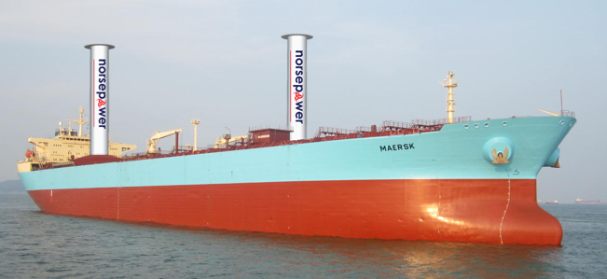
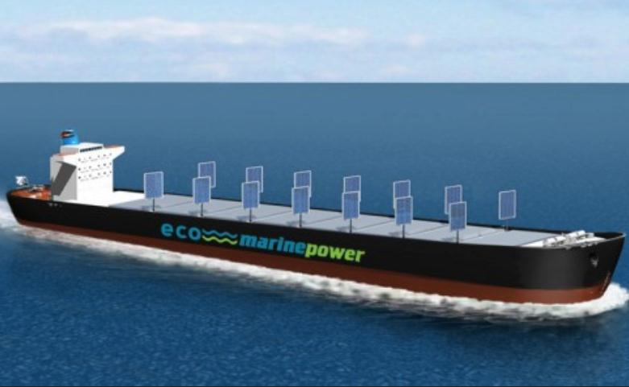
Future shipping fuels
Drivers: policy directives and oil price
Many alternatives but most still in their infancy
LNG
Wind
Electric
Hydrogen
Biofuels
Solar
https://norsepowerltd-public.sharepoint.com/news
http://www.marineinsight.com/green-shipping/top-7-green-ship-concepts-using-wind-energy/

Slide 56
Research agenda
Geopolitics, China, Brexit
How to predict and adapt to new global trade patterns? Maybe less global trade, more intra-regional, low growth?
Should ports upgrade for megaships? Are we critical enough of it? Waste of (public) money?
Environmental performance – still a long way to go.
Which strategies are best? Alternative fuels, cold ironing, regulation, intermodal
Who will lead? IMO? EU? Ports?
How to embed ports more in the community (and local environmental issues not just global)
Is carrier consolidation good or bad for ports?
Resilience to climate change, terrorism, cyber crime

Slide 57
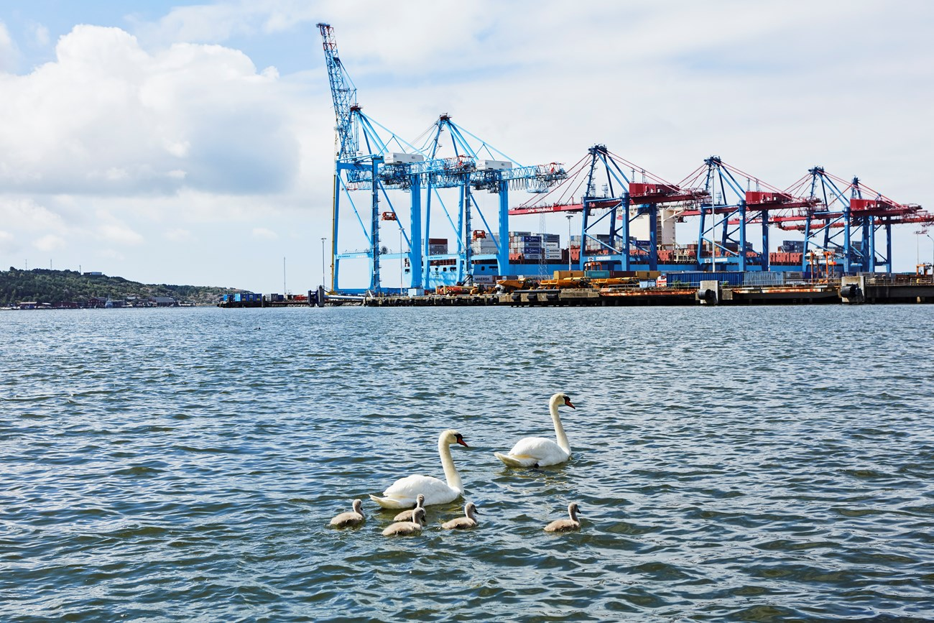
Thank you!
Image: Port of Gothenburg

