Slide 1
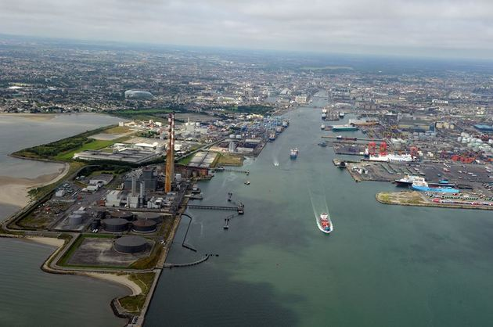
Port Policy and Capacity Development – Case Study in Irish Ports
Eamonn O’Connor
Supervisors
Natasha Evers
Amaya Vega
Stephen Hynes

Slide 2
Outline
Motivation
Methodology
Preliminary Findings
Discussion

Slide 3
1. Motivation

Slide 4
Motivation
Given the prominence of seaborne trade the provision of port capacity is widely recognised as critical for the capability of regions to trade internationally.
In many jurisdictions responsibility for developing capacity is often spread across multiple independent port authorities
Policy makers must ensure that there is appropriate adaptive capacity within the network of port systems to meet future capacity requirements.
The challenge for policy makers is designing appropriate policy frameworks given the role contextuality across a range of port systems.
The objective of research is therefore to explore the role of national policy on capacity development across a range of ports given contextuality

Slide 5
2. Methodology

Slide 6
Methodology
Case study of Irish state owned ports using embedded single case design
Levels of Analysis
Meso – Range of Ports that comprise the Irish port system
Focus of Enquiry - Identifying the factors that are influencing the development of cargo traffic flows
Micro – Individual Port systems and port authorities mandated with developing port capacity to meet national requirements
Focus of enquiry – Identifying the factors that are influencing how port managers are developing capacity in their respective port systems

Slide 7
Methodology
Meso – Examination of Port Traffic Flows in the context of key influencing factors using Notteboom and Roderiques (2007) conceptualisation of the port hinterland into three groups of factors - macroeconomic, physical and logistical over the period 2000-2016
Micro – Semi-structured interviews with senior executives of port companies tasked with responsibility for the development of port capacity were chosen as the primary data collection technique, supplemented with available secondary sources (corporate documents and reports).
Analysis following approach of Miles and Huberman (1994) - data analysis reduced to three cyclical phases: Data reduction, visual display and drawing and verifying conclusions.

Slide 8
3. Findings

Slide 9
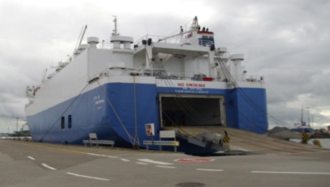
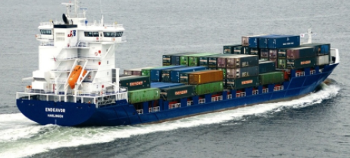
Cargo Traffic Flows
Unitised
Notes:
Point 1 – Need to separate the markets
When looking at traffic flows its important to separate traffic in the Irish system into as the demand dynamics that determine requirements for servicing trade are very different across the sectors
Point 2 – Firstly the Unitised sector consists of RORO traffic, feeder lolo traffic (however one deepsea liner service) and most recently a new form of feeder services that loads containers on mafi trailers in large RORO ships, which is called CONRO but its technically CONRO
Point 3 – Secondly we have the bull sector whichg consists mainly of dry, liquid and break, with some specialised traffic as well

Slide 10
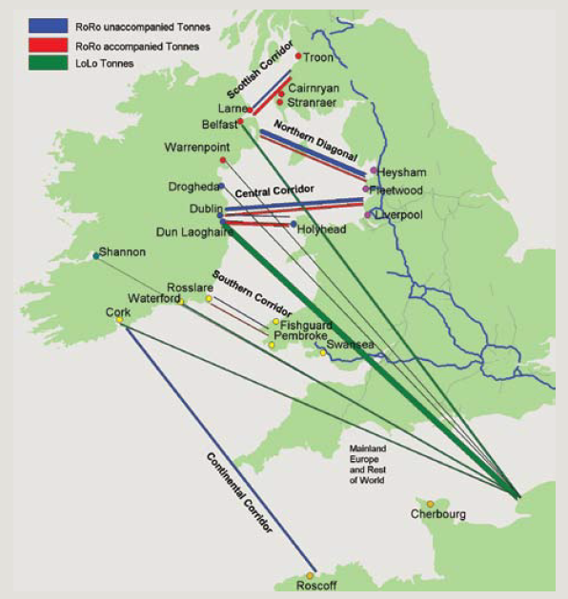
Unitised Sector in Ireland
Source: Intertrade ireland 2005

Slide 11
Market Concentration
Own elaboration based on CSO Data

Slide 12
Growth Across Ports
RORO | 2000 (000's) | 2016 (000's) | CAGR
Total | 18,925 | 26,427 | 2.1%
Dublin | 6,536 | 12,667 | 4.2%
Belfast | 4,551 | 6,615 | 2.4%
Larne | 4,507 | 2,746 | -3.0%
Warrenpoint | 1,002 | 2,182 | 5.0%
Rosslaere | 1,913 | 2,133 | 0.7%
Cork | 191 | 84 | -5.0%
Dun Laoighre | 225 | - | -100.0%
LOLO | 2000 (000's) | 2016 (000's) | CAGR
Total LOLO | 7,715 | 9,156 | 1%
Dublin | 4,176 | 5,062 | 1%
Cork | 968 | 1,889 | 4%
Belfast | 1,294 | 1,680 | 2%
Waterford | 1,014 | 279 | -8%
Warrenpoint | 159 | 246 | 3%
Drogheda | 104 | - | -100%
Source: Own Elaboration based on CSO data

Slide 13
Patterns of Trade
Exports Imports
Own Elaboration Based on CSO Data

Slide 14
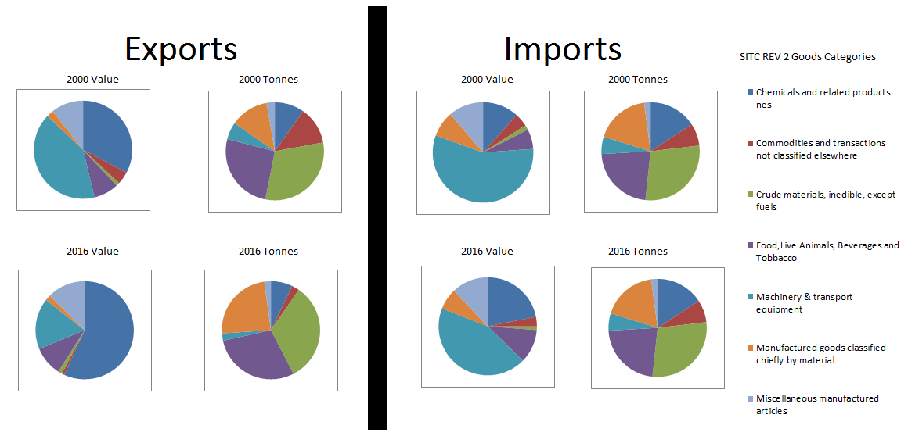
Commodities Traded
Own Elaboration Based on CSO Data

Slide 15
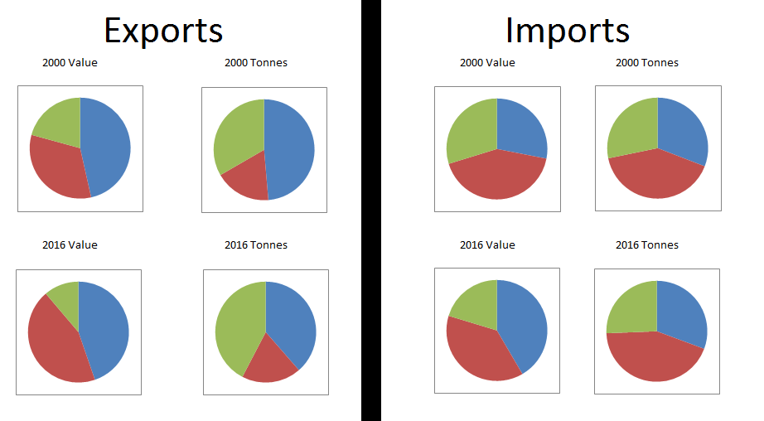
Destinations of Trade
GB EU Non-EU
Own Elaboration Based on CSO Data

Slide 16
Trade imbalance between Imports and Exports
Own Elaboration Based on CSO Data

Slide 17
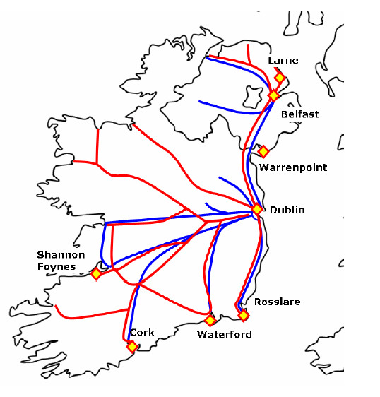
Physical Developments since 2000
Major upgrading of Road Network
Concentration of surface transport infrastructure around Dublin City.
Improved Accessibility to ports particularly Dublin
Minor Upgrading of Port infrastructure across the country, most notably Belfast and Waterford
Source: Competition authority 2013

Slide 18
Logistics Trends
Shipping Lines | Logistic Service Providers
Consolidation in through mergers and acquisitions and concentration in routes in both LoLo and RoRo Introduction of highly successful direct continental CONRO service from Dublin from 2009 Rise of Vessel sharing Arrangements in LoLo sector in early 2000’s with nearly all operators employing VSA’s by 2010 (IMDO) Note: Consolidation in both markets accelerated by effects of the recessionary period | The increased centralisation of inventory amongst logistics service providers in the Greater Dublin Area (GDA) (Intertrade Ireland 2005) The increased utilisation of hub and spoke networks with hubs in the GDA, UK (utilising Ire-UK landbridge) and mainland Europe (Belgium and Holland) Continued prevalence of Road transport (99% Road CSO)

Slide 19
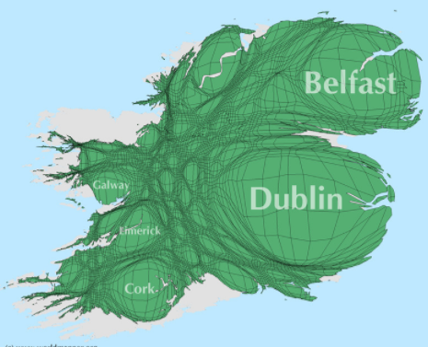
Factors Influencing Observed Trend of centralisation around core ports
Value/volume differential between imports and exports favours concentration of logistics networks around large importation bases i.e. centres of population
Inability to balance loads put ports in exporting corners at disadvantage despite efficiency of port services
Added Reliability of RoRo over LoLo further gives Dublin an advantage for increasingly time sensitive high value cargos
- Major driver of port traffic flows are efficiencies afforded to logistics service providers
Population Density Map of Ireland

Slide 20
National Port Policy (2013)
5 Ports maintained as state owned commercialised port companies as follows:
Tier 1 – Dublin Port, Port of Cork and Shannon Foynes Port Company
Tier 2 – Rosslare Europort and the Port of Waterford
Tier 1 ports mandated to “lead the response of the state commercial ports sector to future national port capacity requirements”
Tier 2 ports have a role to “develop additional capacity to aid competitive conditions within the unitised sectors in particular”
Ports to receive no exchequer funding for infrastructure development or otherwise

Slide 21
Factors Affecting Capability of Port Managers to Respond through addition of capacity
Location of the port and capability to generate traffic flows
Size and import/export balance in hinterland
Power of Intermediaries
Slack in Availability of Physical Resources
Suitable land and depth of water
Access to main inland transportation networks
Reliance on external bodies to develop connecting infrastructure
4. Port operating model and level of private sector participation

Slide 22
Factors Affecting Capability of Port Managers to Respond
Capability to Leverage Finance
Capability to leverage Social License to Operate
Difficulty in obtaining planning permissions and regulatory licenses
External Pressures from non-commercial stakeholders to realise value for port lands
Environmental and Social issues associated with port operations
Support from local and national authorities

Slide 23
4. Discussion

Slide 24
Discussion
Context distorts the effect of common policy framework,
Inherent capability to leverage key resources for port development differs in different port contexts
Scale of operations has consequences for capability to leverage finance contingent on the traffic sector
Geographic location and legacy of dealings with local authorities creates differences in capability to obtain social license to operate across port systems
Critical in the Irish context is supply/competition for critical physical resources

Slide 25
Potential Challenges ahead
Longer Term: Capacity Constraint in Dublin due to scarcity of land may ultimately bound the current centralisation of port traffic flows around Dublin Port and force a deconcentration of port traffic flows to other ports.
Shorter Term: The impact of a hard border between Ireland and the UK will have consequences for the relative attractiveness of the UK land bridge and the imposition of a hard border will put strain on the capability of Dublin port to respond due to land constraints
Key Policy Question: is there enough adaptive capacity in the meso level to facilitate a movement toward deconcentration?
What is the role of policy makers in facilitating this shift?

Slide 26
Discussion Points
Role for Policy Makers in reducing uncertainty surrounding port development process at micro level
– Improvements in integrated planning approach reducing uncertainty around obtaining planning permissions and regulatory approvals
- Policy to ensure there are funding mechanisms available to port managers across system that do not put an overly burdensome constraint on future development

Slide 27
Thank You!

