Slide 1
Modeling urban freight generation: A study of commercial establishments’ freight needs
Iván Sánchez-Díaz, Ph.D.
Senior Lecturer
Chalmers University of Technology
Email: ivan.sanchez@chalmers.se

Slide 2
Outline
The Urban Freight Platform
Introduction
Freight Trip Generation (FTG) modeling
The case of Gothenburg
FTG Applications
Conclusions

Slide 3

VREF Urban Freight Platform
Funded by VREF, researchers from Chalmers and GU
Research themes:
  Urban freight and urban form
  Urban freight operations and policies, future vehicle design and technology
  Stakeholder engagement
+ Facilitating the dialogue and dissemination
      Seminars, workshops, etc
      Research briefs
      E-Book
      VREF Conference on Urban Freight
Visit www.urbanfreightplatform.se for more information
Notes:
Cross-disciplinary research to reach more innovative research

Slide 4
Notes:
Research papers + invited presentations from private public sector and academia

Slide 5
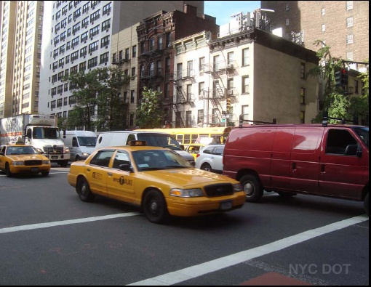
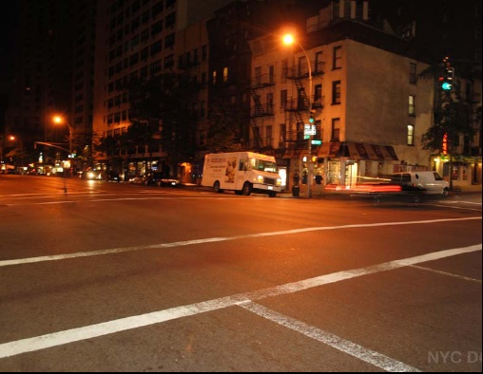
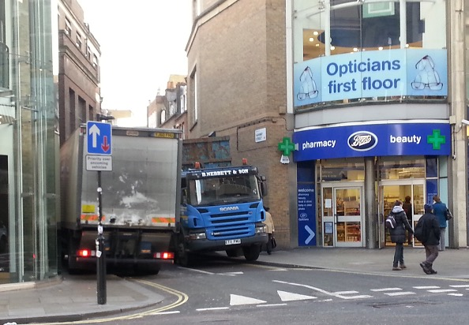
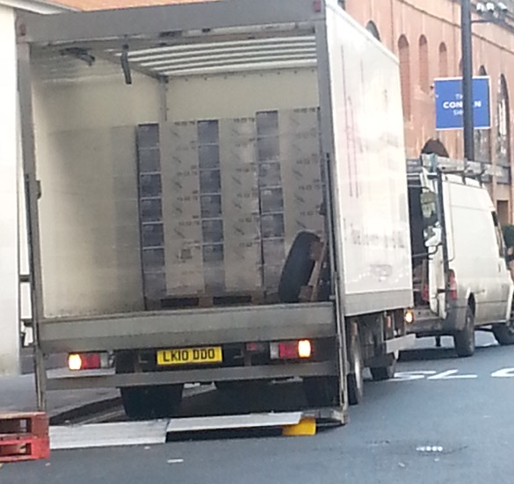
Underutilized-Saturated
20%-30% filling rates
Space use
Notes:
But that may not be true, because we see a lot of inefficiencies, low filling rates (20 to 30%), conflicting space use, Something is not working well

Slide 6
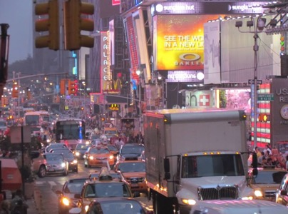
Introduction
Improving the urban freight system requires:
  Understanding the system
  Modeling the system
  Identify the problems and the causes
  Formulate initiatives /solutions
  Assess these initiatives / solutions
  Implement solutions
The classical travel demand model (Ortuzar and Willumsen, 2010):
  Trip generation
  Mode split
  Trip distribution
  Traffic assignment
Freight demand models have adopted a similar structure

Slide 7
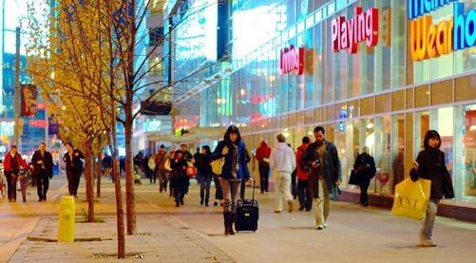
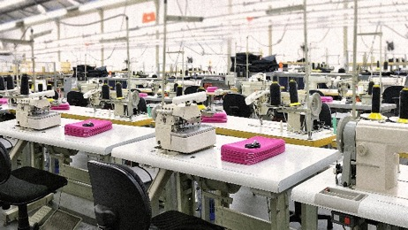
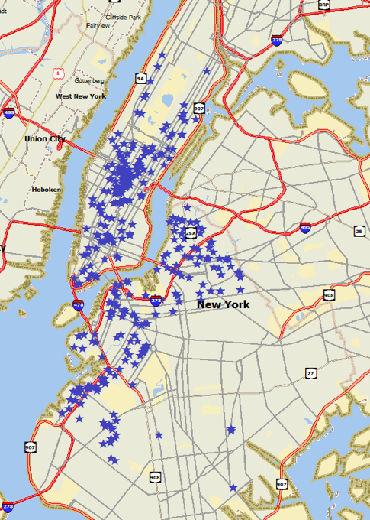
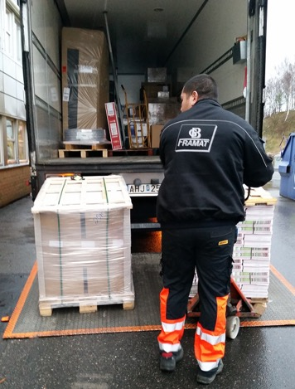

Introduction
We want to improve our knowledge: First question we should ask:
  Who is generating (and where) this urban freight traffic being?
https://en.wikipedia.org/wiki/Shopping
https://www.fastcodesign.com
https://www.fashionindustry.com
Notes:
The starting point to understand freight demand is to study freight trip generation

Slide 8
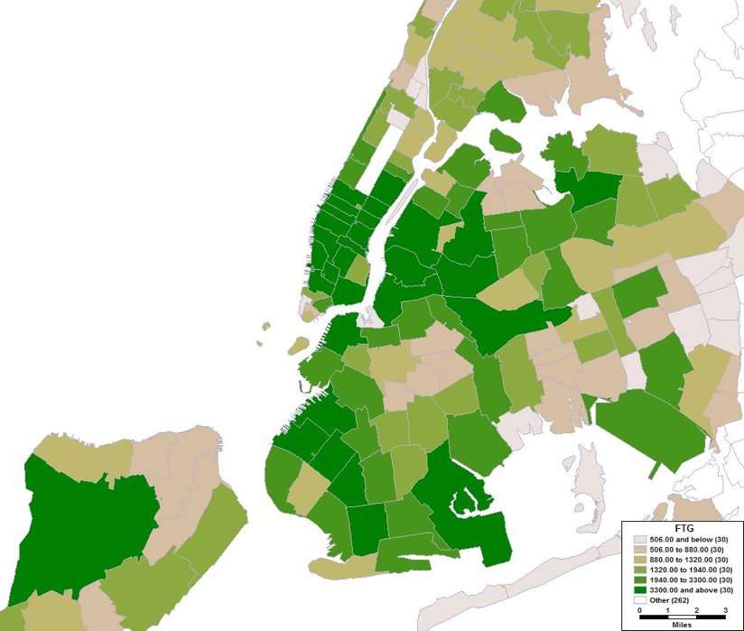
Freight Trip Generation
Freight trip generation (FTG) models are a tool to quantify the number of trips that are generated by commercial establishments
FTG models allow to answer:
  Who generates the freight traffic?
  How much traffic is generated?
  Where is it generated?
Notes:
Here is the case of NYC. But to better understand FTG phenomenon we need to go to the agent at the root of demand, the establishment/ shop

Slide 9
Freight Trip Generation: The Data

Slide 10
Key findings from previous FTG studies
Freight Generation and Freight Trip Generation are 2 ≠ things
  Generation of demand, e.g., tons,
    economic manifestation of production/consumption
  Generation of traffic, e.g., truck trips
    generation of traffic is the result of logistical decisions
Nonlinear effects:
    Changes in shipment size -> vehicle/mode changes
FTG is affected by location:
    Land-value
    Width of front street
    Clusters, i.e., establishments close to others in same sector have higher FTG

Slide 11
Modeling techniques
Trip rates per establishment or per employee
Multiple classification analysis
Artificial neural networks
Ordinary least squares
Nonlinear models (log-log, lin-log)
Ordered logit models
Spatial autocorrelation models

Slide 12
The case of Gothenburg: Understanding receivers needs

Slide 13
Data description
Notes:
Briefly about the data, we used a stratified sampling to cover the city, and some sectors of interest. About 200 observations collected both via electronic surveys, phone calls and personal interviews/measurements

Slide 14
Freight generation
Notes:
As shown, retailers of perishable goods tend to attract the largest quantities of freight, with 36% of them attracting more than 1000 kg per week. For the food service sector, about 20% attract more than 500 kg per week.

Slide 15
Logistics decisions affecting FTG
Notes:
most establishments no clear ordering/ stockholding policy. Sometimes ordering/ stockholding policy centralized
When a policy exists: every item needs to be always available in the store, fresh products should always be available, storage space utilization should be maximized, first in first out policy, high storage for products traveling long distances, the shelves of the store are the stock, and cooled space limits stock.
More retailers have a policy than restaurants.
Not many receivers pay for their deliveries, this seems to be the case primarily for non-perishable retailers→ maybe no incentives to consolidate deliveries, increase shipment size and reduce FTG
SMALL SAMPLE

Slide 16
FTG and FG models
Highlights:
Employment model performs better for FTA, area model better for FWA
Effect of employees on FTA is larger for retailers (1.73 extra trips/employee), followed by food services (0.55 extra trips/employee)
Retailers of perishables attract more FWA
Effect of employees on FWA similar for most sectors
Effect of area on FWA is larger for retailers and food services
These models allow quantification
Notes:
Different specifications: in this case linear pooled models where binary variables and interactions represent the effects of commercial sectors and business size. Use of an ordinal variable an a ordered logit model

Slide 17
Validation with traffic
Summary of traffic results from the cordon-based study for Domkyrkan area, Gothenburg
2 days of counts: 219 freight vehicles entered the zone on Wednesday and 170 on Thursday, for an average of 195 (excluding waste collection, construction and maintenance, and service vehicles).
Summary of FTG application to same area
FTG estimates: 239 freight trips (including private vehicles doing deliveries, i.e., 20% based on surveys)
Notes:
Useful to complement FTG models with information from traffic counts, such as distribution across time

Slide 18
FTG numbers from around the world

Slide 19
FTG in Gothenburg, Stockholm, New York City, Lisbon, Paris, Lyon, Medellin and Chennai
A typical retail establishment in Chennai, in Lyon, in Medellin, or in Stockholm, receives about 2 daily deliveries, in Paris 3 and in NYC 4
A small grocery store located in Stockholm, NYC, or Seattle attracts in average 5 daily deliveries
A small restaurant located in Chennai, Lisbon, Lyon, Stockholm, Paris or NYC attract about the same number of deliveries, 2 per day

Slide 20
Application of FTG Models

Slide 21
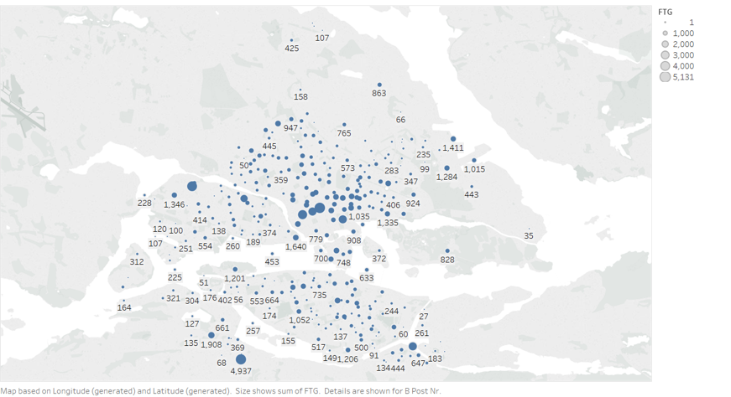
Where do the deliveries go?
Gothenburg
Stockholm
Notes:
First step in 4 steps models
Gothenburg: 1M, 15,000 estab, 20,000 trips per day
Stockholm: 1M, 11,279 estab, 33,000 trips per day
NYC: 1.5M, 40,000 estab, 190,000 trips per day

Slide 22
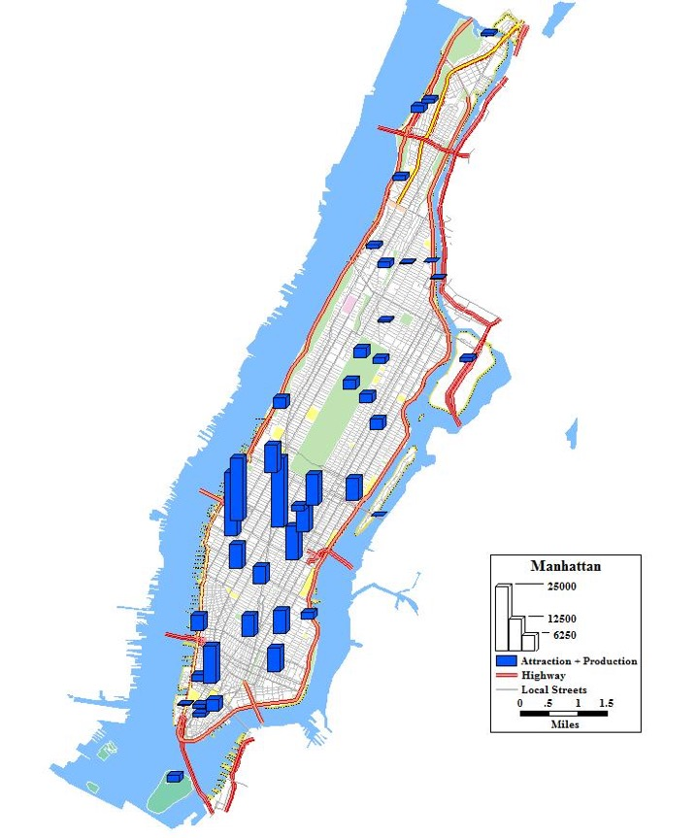

Where do the deliveries go?
In Manhattan:
56 buildings create about 4% of delivery traffic

Slide 23
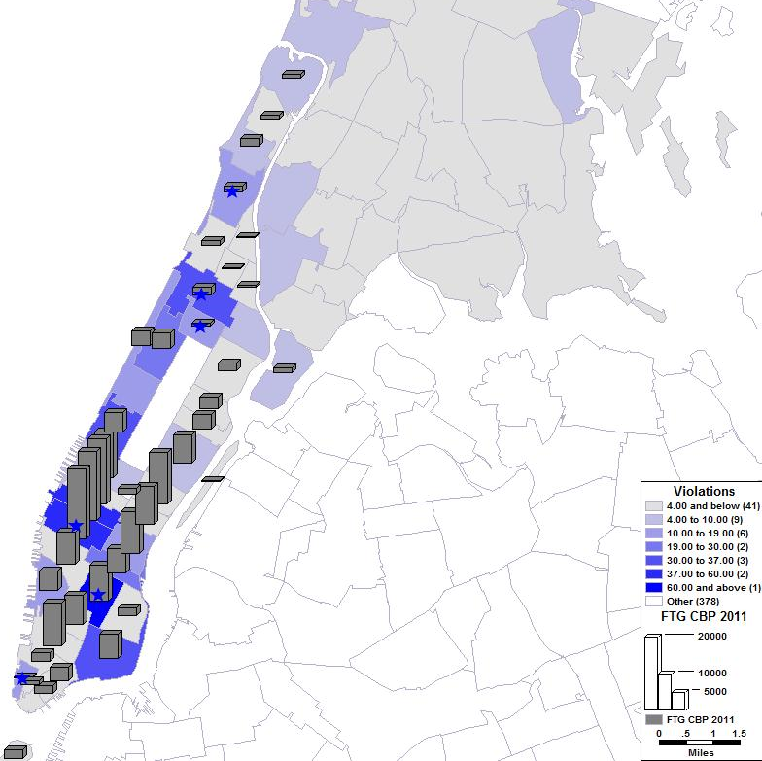
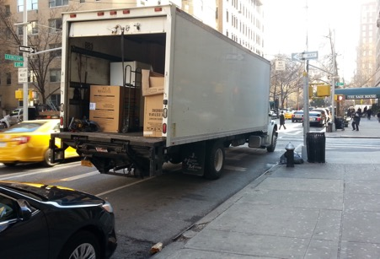
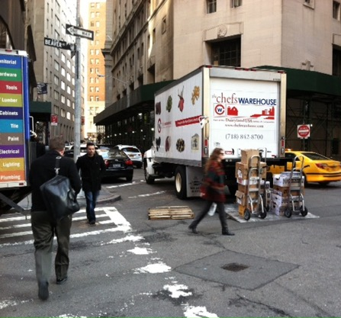
Parking study
10 ZIP codes with freight parking demands larger than the parking capacity of the streets (Jaller et al., 2013)
Comparison with parking violations

Slide 24
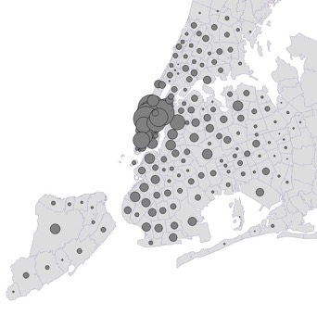
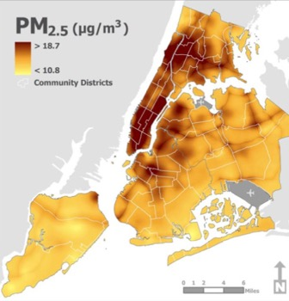
Assess freight initiatives
Quantify potential savings in trips made:
  Unassisted-off hour deliveries using incentives (savings: about 150M dollars/year) (Holguin-Veras et al., 2017)
  Receiver-led consolidation programs (savings: about 150-200M dollars/year) (Holguin-Veras and Sanchez-Diaz, 2016)
First step to estimate vehicle miles traveled savings
Cost-benefit analyzes

Slide 25
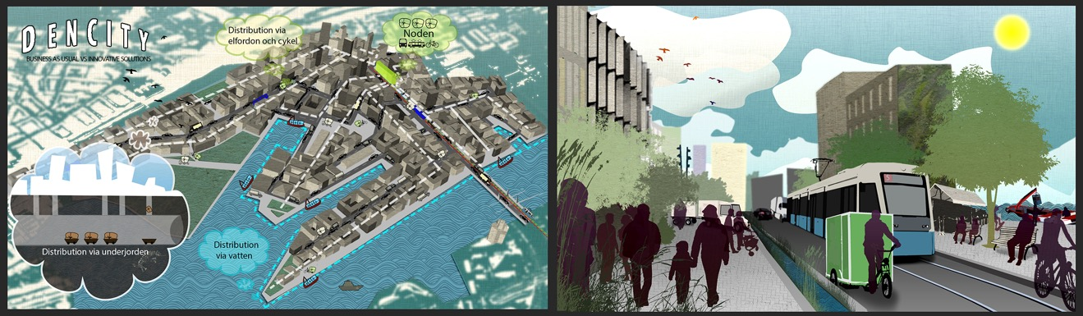
Plan new developments
Plan innovative ways to receive freight for 18.000 inhabitants and 3.600 new commercial establishments which will generate about 12.000 deliveries per week
Loading zones needs, building codes

Slide 26
Conclusions
Amount and impacts of urban freight traffic depends on demand and inventory policies of establishments and households
Collecting data and modeling Freight Trip Generation (FTG) using establishment-based surveys allows forecasting and policy analysis
Statistical models can be used to quantify freight traffic. Models can be improved via segmentation between sectors, controlling by business size, and through sophisticated functional forms
Quantifying freight traffic – via FTG modelling – is crucial to understand local needs, assess potential solutions to existing problems, and anticipate future needs
Modeling FTG is just a first step
  (i) mode/vehicle type choice, routes, and traffic assignment
  (ii) policy and infrastructure assessment

Slide 27
Thanks for your attention!
Iván Sánchez-Díaz, Ph.D.
Email: ivan.sanchez@chalmers.se

Slide 28
References
Sánchez-Díaz, I., (2016). “Modeling urban freight generation: A study of commercial establishments’ freight needs.” Transportation Research Part A: Policy and Practice.
Sánchez-Díaz I., J. Holguín-Veras and X. Wang (2015). “Freight Trip Attraction Modeling: An Exploratory Analysis.” Transportation, (in print) DOI: 10.1007/s11116-014-9570-1.
Holguín-Veras, J., I. Sánchez-Díaz, C. Lawson, M. Jaller, S. Campbell, H. Levinson and H.S. Shin (2014). “Transferability of Freight Trip Generation Models.” Transportation Research Record: Journal of Transportation Research Board. 2379, pp. 1-8 ISSN 0361-1981. http://trid.trb.org/view.aspx?id=1241343.
Lawson, C, J. Holguin-Veras, I. Sánchez-Díaz, M. Jaller, S. Campbell, and E. Powers (2012) “Estimated Generation of Freight Trips Based on Land Use” Transportation Research Record: Journal of Transportation Research Board. 2269, pp.65-72. ISSN 0361-1981. http://trb.metapress.com/content/gh65742213115h42/.
Jaller M., I. Sánchez-Díaz, and J. Holguín-Veras (2015), “Freight Trip Attraction, Freight Trip Production, and the Role of Freight Intermediaries.” Transportation Research Record: Journal of Transportation Research Board (in print).
Holguín-Veras J., M. Jaller, I. Sánchez-Díaz, S. Campbell and C. Lawson (2013). “Freight Generation and Freight Trip Generation Models” in Freight Transport Modelling. Elsevier, ISBN: 9780124104006.
Sánchez-Díaz I., J. Holguín-Veras and M. Jaller (2015). “Freight Trip Generation Modeling.” VREF Research Brief.
Holguín-Veras, J., M. Jaller, I. Sánchez-Díaz, J. Wojtowicz, S. Campbell, H. Levinson, C. Lawson, E. Powers and L. Tavasszy (2012). NCHRP Report 739 / NCFRP Report 19: Freight Trip Generation and Land Use. National Cooperative Highway Research Program / National Cooperative Freight Research Program. Washington D.C., Transportation Research Board of the National Academies: 165. http://www.trb.org/Main/Blurbs/168396.aspx
Sánchez-Díaz I., J. Holguín-Veras and J. Ban (2015). “A Time-Dependent Freight Tour Synthesis Model.” Transportation Research Part B: Methodological.
Holguín-Veras J. and I. Sánchez-Díaz (2015). “Freight Demand Management: Receiver-Led Consolidation Programs.” Transportation Research Part A: Policy and Practice.

Slide 29


Slide 30
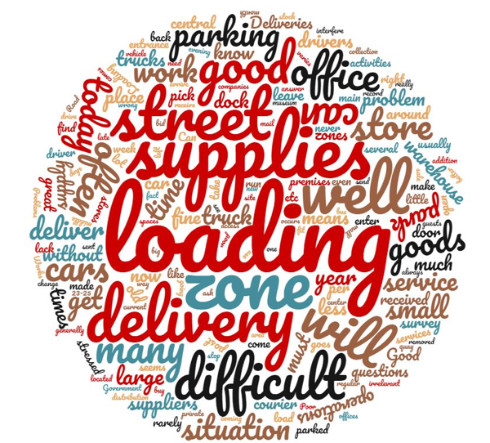
Some comments from respondents
“A lot goes in and out at 7 am. Residents movements interfere with deliveries”
“We could have had a completely different logistics at other times, but because it is located at the bottom of an apartment building there are tenants who mind really if a car comes before 07.00 in the morning”
“People park at the loading site. NOT OK. must be fined and removed immediately”
“There is nowhere for cars to stop. Everything crashes, bicycles, pedestrians, cafe sitting, cars, etc.”
“The drivers say that we were not in place, it is difficult to deliver to the old town. We will then ask for a new delivery or pick at PostNord center or service point-op with delays and hassles”
“Road works that block the delivery entrances, noisy wheels on carts, negligence in garbage collection, outstanding delivery (cardboard and garbage collection)”
“Construction in the area could interfere with operations”
“I am very much in favor of a change in urban planning in Stockholm, everything to make the city more bicycle / pedestrian friendly. It is time that the old car lovers who decide in the City of Stockholm retire: -) !!!”

Slide 31


Freight Trip Generation
Freight trips are the result of 2 types of activities:
  A delivery or freight trip attraction (FTA)
  A freight trip production (FTP), e.g., shipment/pick-up
Each produce 1 inbound trip and 1 outbound trip
Inbound Trips
Outbound Trips
Inbound Trips
Outbound Trips
Loaded Trip
Empty Trip
Empty Trip
Loaded Trip
Establishment
Establishment
a) FTA (e.g., delivery request)
b) FTP (e.g., pick-up request)

Slide 32
Stockholm

