Slide 1
Innovative practices in urban freight distribution Current situation
Vila-real, 29 September 2017

Slide 2
INDEX
1. Last mile deliveries in cities
2. Logistic strategies
3. Detected shifts and future innovations

Slide 3
1. Last mile deliveries in cities
City Logistics
Cities are becoming denser in population, European cities are facing enormous challenges in terms of accessibility and livability.
Last mile distribution is especially getting attention for investors and media for its interests in economy.
Last mile deliveries in urban areas represent one of the major concerns, especially in cities. In Europe, around 15-20% of vehicle kilometers are covered by Urban Freight vehicles. They are responsible for up to 50% of NOx emissions (Dablanc, 2011)
The European Commission's Transport 2050 Strategy proposes a target of 60% greenhouse gas emission reduction by 2050. It sets goals for the different modes of transport, including CO2-free city logistics in major urban centers by 2030 (European Commission, 2011).

Slide 4
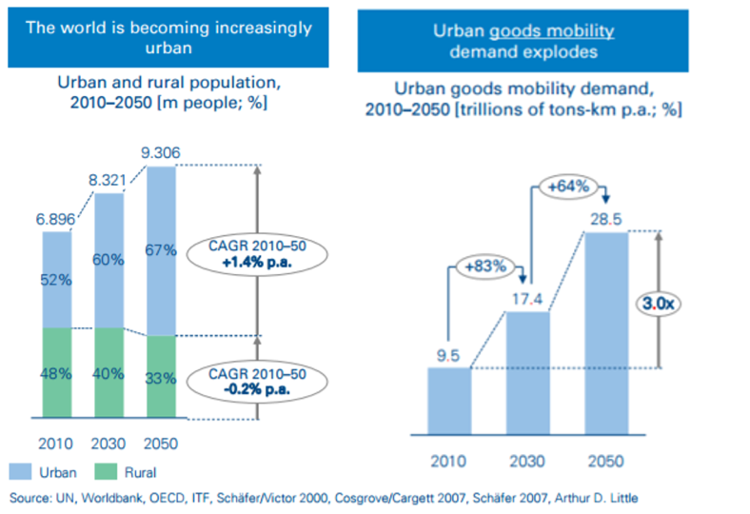
1. Last mile deliveries in cities
City Logistics
Today, 64% of all travels happen within urban environments, and the total amount of kilometers traveled by freight vehicles is expected to triple by 2050.
As growing number of vehicles in urban areas implies increased congestion, air pollution and noise, which negatively impact traffic safety, quality of life and urban economic competitiveness, more and more cities are experiencing issues related to last mile delivery of goods.
Although cities are addressing challenges associated to passenger mobility, strategies for last mile delivery of goods at city level are often missing.

Slide 5
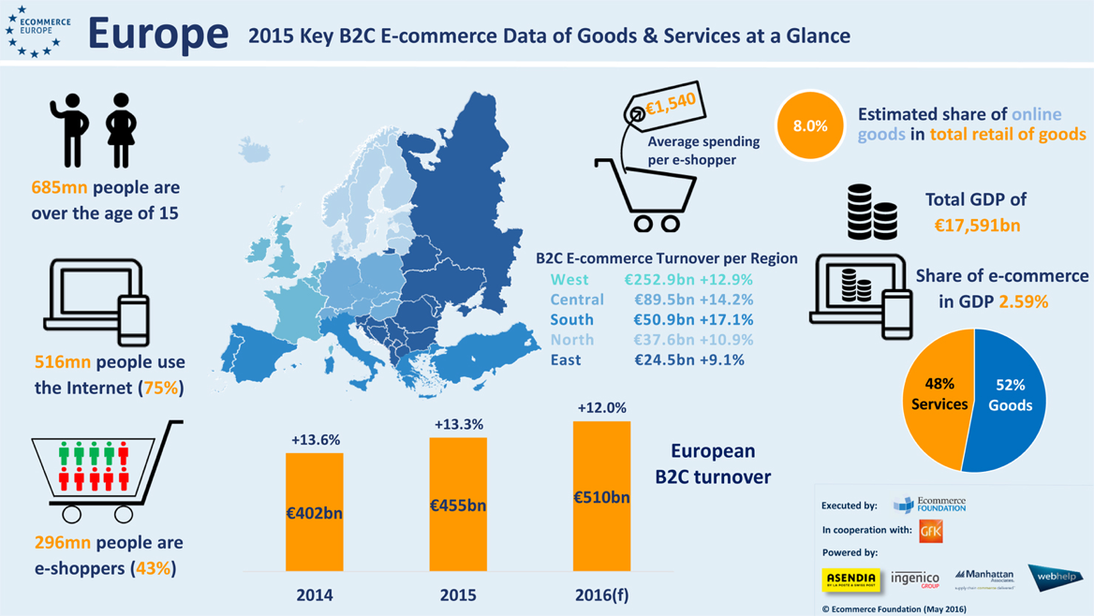
1. Last mile deliveries in cities
Increase of E-commerce
According to the European Commission, E-retailers consider that delivery services are one of the fundamental factors that determine a consumer’s decision to shop with them and they have developed a wide range of services which offer flexible hours, reduced prices and fast deliveries.
From a city logistics point of view, home deliveries constitute the most problematic solution in terms of service costs and organization however consumers seek express, arranged and reliable services.

Slide 6
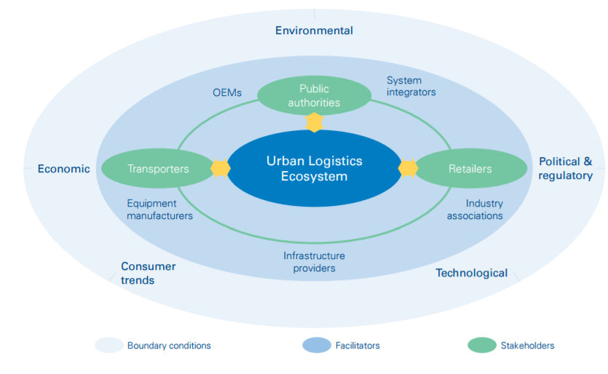
1. Last mile deliveries in cities
Stakeholders
Last mile delivery of goods involves several levels of complexity including multiple stakeholders. The most important ones are: Public authorities, Transportation companies, Retailers and Consumers.
Each of these may have diverging interests and objectives. These stakeholders often lack shared understanding of the priorities and most appropriate action levers.
This complexity often leads to enforcement of partial, sub-optimal or even counter-productive decisions and solutions.

Slide 7
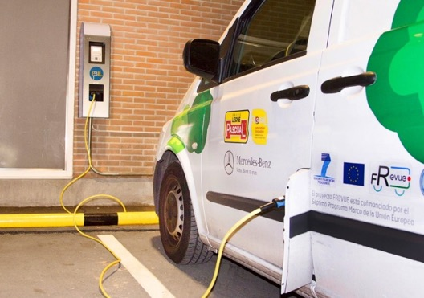
2. Last mile deliveries in cities
Urban logistics impacts
Last mile distribution strategies can contribute to improve the negative impacts og urban logistics. Those can be influenced by different factors and may even conflict and require careful prioritization according to the city.
Urban congestion, influenced by distance traveled, vehicle capacity
Number of trucks in the city, influenced by vehicle capacity, vehicle filling ratio and congestion level
Pollution, influenced by vehicle type, distance traveled and congestion level
Noise, influenced by vehicle type, distance traveled and congestion level
Energy consumption, influenced by vehicle type, distance traveled and congestion level
Development of local retail, influenced by solution costs, which are defined by service quality
EV installation for FREVUE in Madrid (Ayuntamiento de Madrid, 2014)

Slide 8
2. Last mile deliveries in cities
Improvements in Last Mile Distribution
Alternative fuels: hybrid, electrical, etc.
Vehicle improvements
Type of vehicle: cargocycles, automatic vehicles, etc.
Strategy improvements: network design
Tactic improvements: equipment and infrastructure management.
Operational improvements: policy, information systems…
Supply Chain Logistics
Urban logistics goals:
Reduction of urban congestion
Reduction of number delivery vehicles
Reduction of the pollution
Reduction of noises associated
Energy saving
Development of local retail
Logistic strategies:
Urban consolidation centers
Off-hour distribution
Pick-up points
Regulatory measures:
Access regulation
Load parking regulation

Slide 9
1. Last mile deliveries in cities
2. Logistic strategies
3. Detected shifts and future innovations

Slide 10
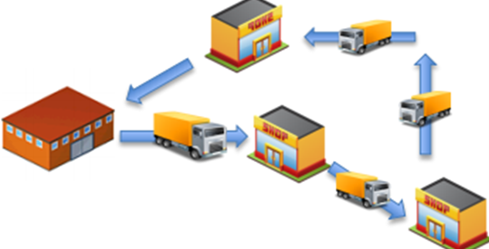
2. Logistic strategies
Urban Consolidation Centers
Large trucks do not need to carry out last mile small-scale deliveries
UCC (Urban Consolidation Centers) allow to bundle freight and carry out a more efficient last-mile distribution for a specific area.
Large trucks are replaced by alternative vehicles, improving the environmental conditions.
Private carriers and retailers do not appreciate much the benefits because they base their activities in economical balances.
Public sector is clearly the most satisfied stakeholder involved in urban consolidation centers.

Slide 11
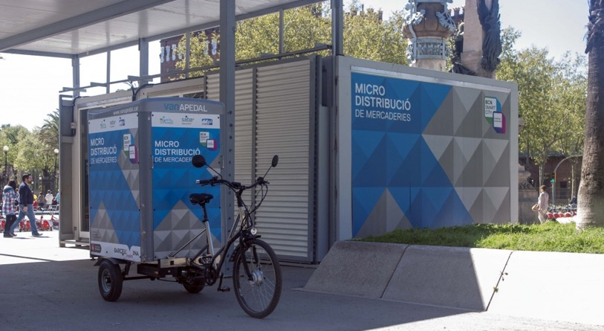
2. Logistic strategies
Urban Consolidation Centers
UCC pilots in BARCELONA, 2014
5 months trails within SMILE project, funded by EU.
Small-scale UCC was tried combining the use of two electric tricycles (cargo cycles) and an urban transshipment terminal located in the inner city.
Promoted by the City Council but with strong cooperation of Vanapedal, as private operator.
Large vehicles left the goods in the UCC and, during the same day, Vanapedal managed to deliver these parcels to the retailers and final customers. Three operators had regularly used the transshipment terminal and three more were using it occasionally.
64
Van km/day
saved
2.400
Liters of fuel saved during the pilot
1,9
CO2 tones saved during the pilot
Transhipment terminal (Valenciaport Foundation, 2014)

Slide 12
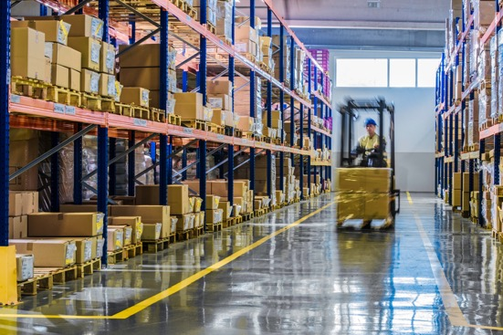
2. Logistic strategies
Urban Consolidation Centers
Conclusions and key considerations:
Most of UCC gains satisfy society
More expensive deliveries for private sector
Difficult to carry out projects without public grants.
An option to promote UCC is to introduce new access regulations in specific areas.
To maximize benefits it is crucial the interaction between all the stakeholders.
60%
Urban freight
Kilometers saved
24-90%
Reductions
of CO2

Slide 13
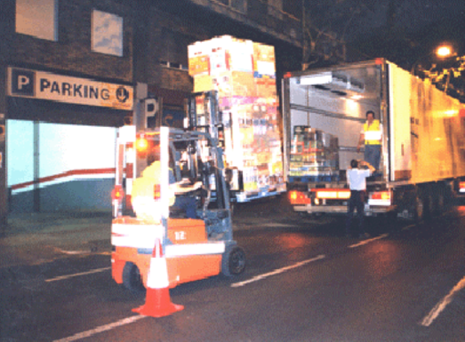
2. Logistic strategies
Off-hour distribution (OHD)
Slow operations in peak hours, producing congestion and pollution
OHD (Off-hour distribution) allows to reduce peak time deliveries improving the efficiency on freight distribution operations within cities.
Simpler schemes and routes are possible.
Special interest for supermarkets and big businesses.
For carriers and retailers, the deliveries are more efficient, for its time savings.
Public sector is interested as well because it is a measure that can improve significantly the congestion levels in peak hours.
it is needed a legal framework to regulate the time windows and noise levels.
(Hayes, 2006)
13

Slide 14
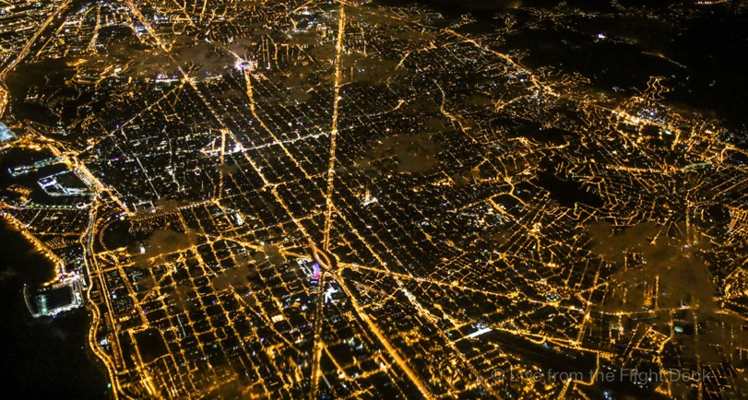
2. Logistic strategies
Off-hour distribution (OHD)
Night deliveries in BARCELONA
In 2003 it was tried the first OHD trail within MIRACLES-CIVITAS, an EU project.
It was conducted by the national chain of supermarkets Mercadona with collaboration of the City Council using an adapted 40 tones truck for noise matters. Deliveries were carried out in the periods 05.00-06.00 h and 23.00-24.00 h.
Along 2006 and 2007 trails restarted involving more supermarket chains and noise measurements were taken in different locations.
Currently some supermarkets keep night deliveries as routine.
1
Hour per trip
is saved in each
supermarket
7
Conventional trucks can be replaced using 2 trucks of 40 tones

Slide 15
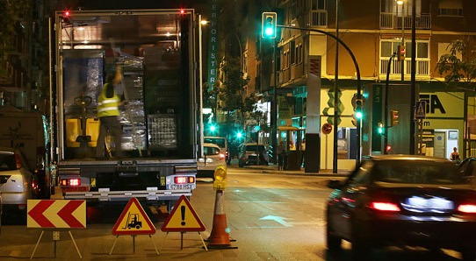
2. Logistic strategies
Off-hour distribution (OHD)
Conclusions and key considerations:
Efficient logistics
Better working conditions
Noise problems
Have an adequate legal framework to facilitate operations avoiding complains.
Adapt OHD slowly and cautiously in order to be accepted for the population.
Public cooperation to acquire silent vehicles and equipment.
15-60%
Travel time savings
12-55%
Reductions
of CO2

Slide 16
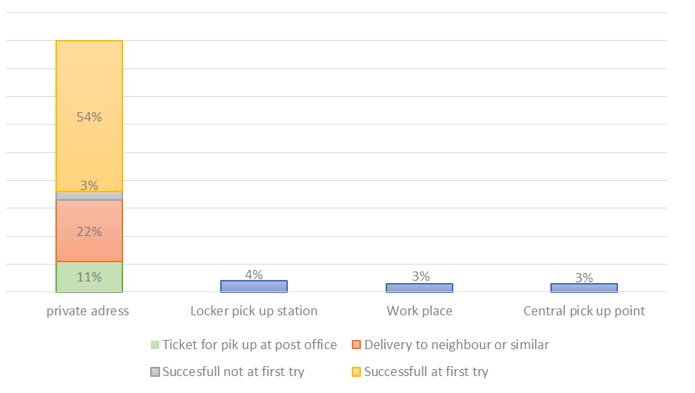
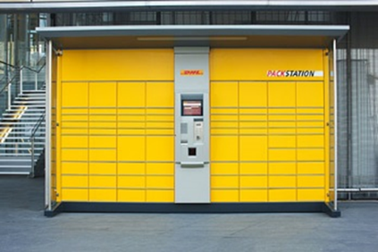
2. Logistic strategies
Pick-up points
More than one trip is needed to deliver a parcel and there are too many addresses
Current forms of deliveries used in Germany (Morganti, Dablanc, & Fortin, 2014)
DPDHL locker station (Packstation)
Logistic operators create pick-up point networks in order to avoid door to door distribution, but offering shipments close to the desired addresses. The delivery process is finished at the first try avoiding multiple trips.
Special interest for small parcels to particulars.
2 types: Attended pick-up points or lockers.

Slide 17
1. Last mile deliveries in cities
2. Logistic strategies
3. Detected shifts and future innovations

Slide 18
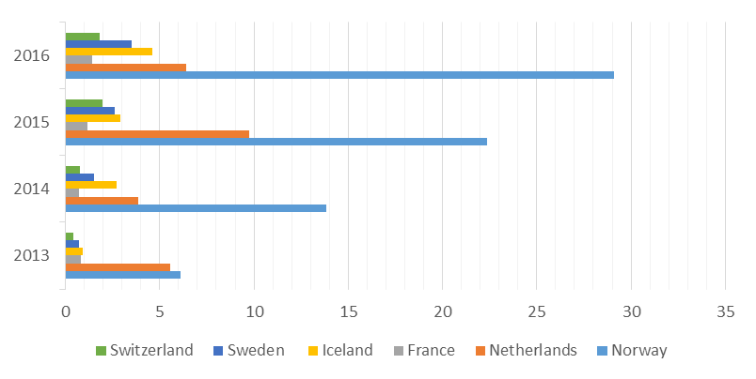
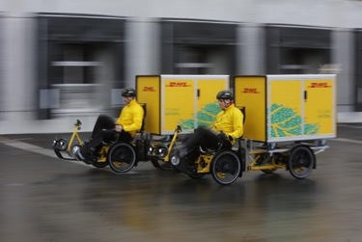
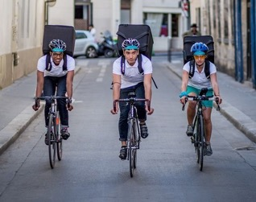
3. Detected shifts and future innovations
Last mile distribution is a great chance to incorporate EV for its repetitive routes.
Limited models, infrastructure and technical support in an impediment.
It is needed public sector involvement because benefits are basically for citizens.
Electric vehicles
EV market share (2013-2016)
Alternative to face with strong restrictions in complex urban areas.
Parcel deliveries, point to point.
Some operators are shifting their urban fleets.
Startups based on shared economy concept.
Low investment requirements.
Problems with legal and liability concerns.
Shared economy
Crowdsourcing apps
Cargocycles

Slide 19
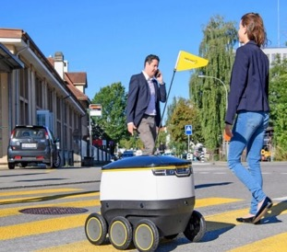
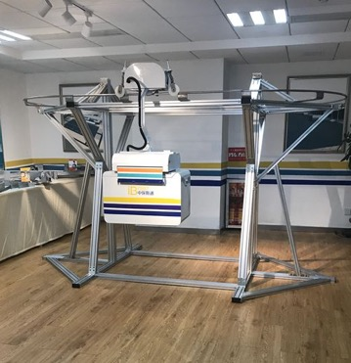
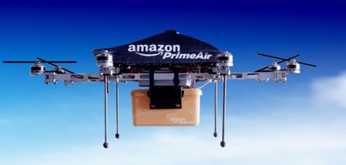
3. Detected shifts and future innovations
Near future
Slow velocity, navigating using a mixture of geolocation signals and visual recognition
Future of last mile distribution consider ambitious options to deliver parcels without any human intervention.
These are still over development and only few companies invest resources on them.
Droids
Droid prototype (Swiss Post)
Direct routes at relatively high speed, designed to cover rural areas.
Low-altitude static cable rails.
Low energy consumption, but high visual contamination
Delivery drone prototype (Amazon)
Drones
Cable rail
Cable rail prototype (iBosst Ltd.)

Slide 20
Jordi Girona, 1-3 C-3, S-120
08034 Barcelona, Spain
T. +34 93 413 76 67 www.cenit.es
Miquel Iranzo
CENIT
miranzo@cimne.upc.edu

