Slide 1

URBAN I
VPF AND SUSTAINABLE URBAN LOGISTICS. PROJECTS AND EXPERIENCES IN VALENCIA
Salvador Furió
(Fundación Valenciaport)

Slide 2

URBAN I - VPF AND SUSTAINABLE URBAN LOGISTICS. PROJECTS AND EXPERIENCES IN VALENCIA
Retail e-commerce Mail post & courier
HORECA Waste Construction
> 50% population lives in urban areas
freight
urban
transport
impacts
congestion
emissions
noise accidents
transport
> 40% CO₂ emissions
EU vision
Minimise freight movements & distances
Reduce vehicle emissions
IT to increase efficiency
Reduce noise levels
CO2-free city logistics
by 2030
Policy & incentives
new solutions & tech R+D+i
Infrastructures
low emission vehic
ITS better data & planning
UCC & intermodal f
efficient deliveries
night deliveries
etc…

Slide 3



URBAN I - VPF AND SUSTAINABLE URBAN LOGISTICS. PROJECTS AND EXPERIENCES IN VALENCIA

Slide 4











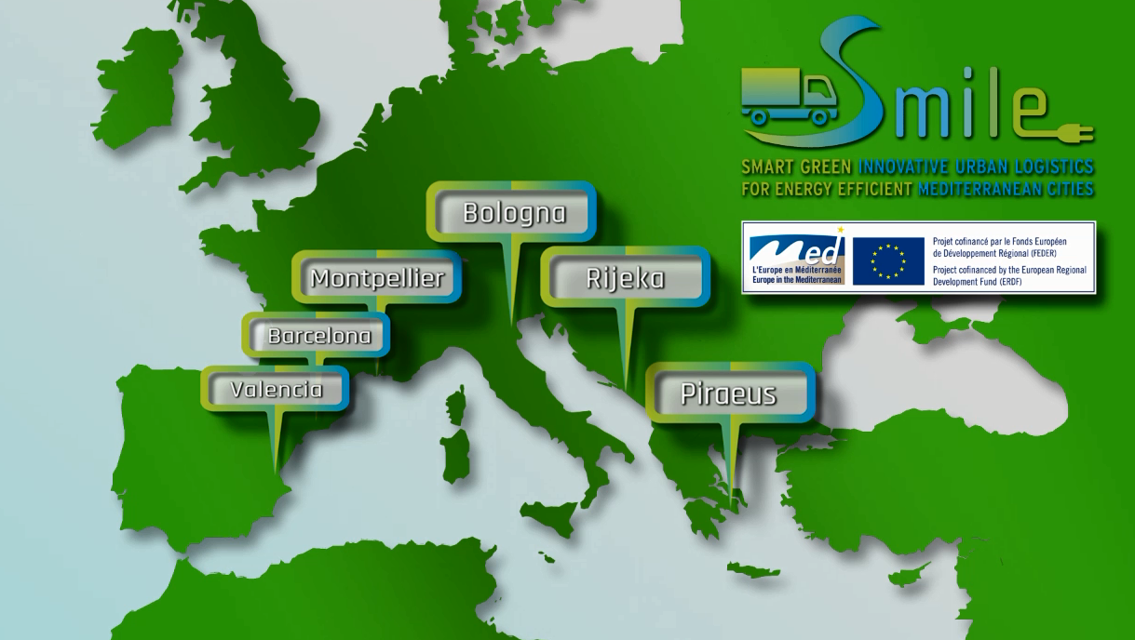
URBAN I - VPF AND SUSTAINABLE URBAN LOGISTICS. PROJECTS AND EXPERIENCES IN VALENCIA
The aim was to test innovative urban logistics solutions to improve the energy efficiency of Mediterranean cities (9 pilots, 6 cities, 5 countries, 11 partners)
Research Centres
Municipalites

Slide 5
URBAN I - VPF AND SUSTAINABLE URBAN LOGISTICS. PROJECTS AND EXPERIENCES IN VALENCIA
TYPES of Pilots
Valencia
Barcelona
Montpellier
Electric vehicles
for distribution
Marketing
tools
Electric vehicles
for distribution
Valencia
Montpellier
Marketing
tools
Technologies for
automation
and control
Operative tools
for optimization
Technologies for
automation
and control
Operative tools
for optimization
Piraeus
Bologna
Piraeus
Rijeka

Slide 6
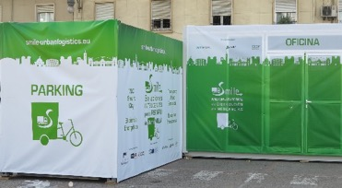

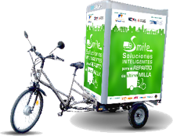
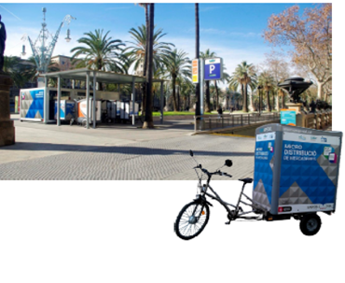
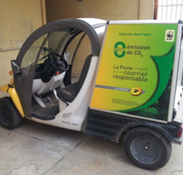
URBAN I - VPF AND SUSTAINABLE URBAN LOGISTICS. PROJECTS AND EXPERIENCES IN VALENCIA
Last mile distribution of parcels using an UCC and electrically-assisted tricycles
Last-mile postal distribution using a electric bikes (QUADEO) and cargo bikes

Slide 7
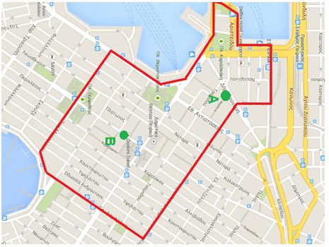
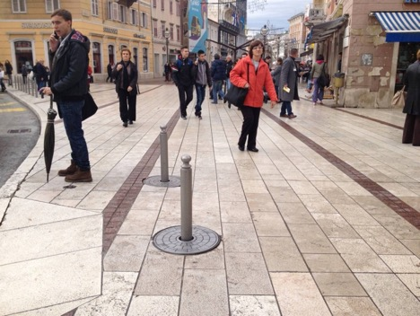
URBAN I - VPF AND SUSTAINABLE URBAN LOGISTICS. PROJECTS AND EXPERIENCES IN VALENCIA
Automatic retractable bollards to provide parking areas for urban freight distribution
Automatic bollards to control the access to the centre of Rijeka

Slide 8
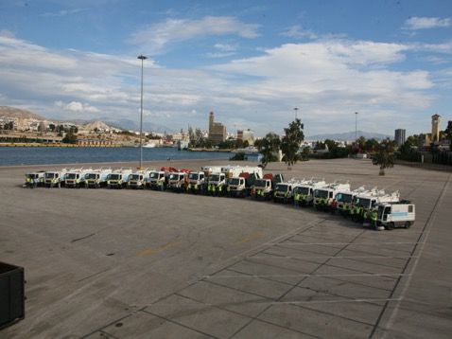
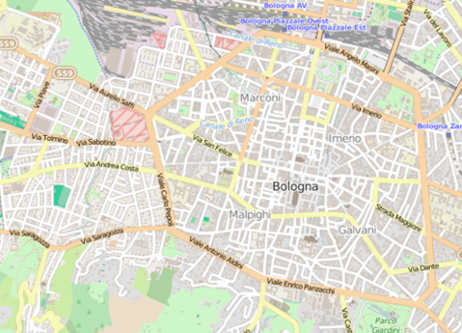

URBAN I - VPF AND SUSTAINABLE URBAN LOGISTICS. PROJECTS AND EXPERIENCES IN VALENCIA
Reorganize the waste collection system in the city center and new waste collection equipment
Optimized IT-supported planning methodology for waste collection in “West Bologna” area

Slide 9



URBAN I - VPF AND SUSTAINABLE URBAN LOGISTICS. PROJECTS AND EXPERIENCES IN VALENCIA
Foster transport companies to register in carbon footprint register following the Objectif CO₂ methodology
Foster transport enterprises working with the Municipality of Montpellier to enter in the Objectif CO₂
Notes:
This pilot has designed a methology to assist Logistics companies to calculate their carbón footprint and to define an reduction plan (diveded by 4 main áreas: vehicle, driver, fuel and organization) This activities can be done following the Objetif CO2 (a frech labeeling scheme for transport companies) with the aim of achive the spanish carbón footprint registre. This is a new register promoted by the Spanish Ministry.

Slide 10

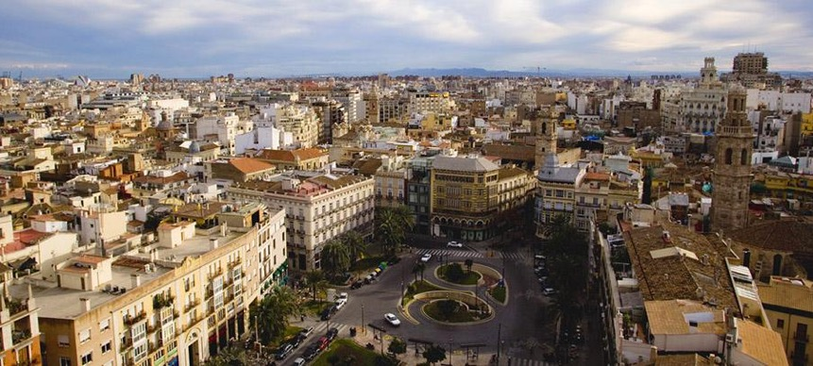
URBAN I - VPF AND SUSTAINABLE URBAN LOGISTICS. PROJECTS AND EXPERIENCES IN VALENCIA
UCC and electrically-assisted tricycles
VALENCIA
3 ^{st} biggest city in Spain
15,083 commercial stores
5-25 weekly freight deliveries (13 minutes)
1,463 areas for loading and unloading
CONTEXT
HISTORICAL CENTRE
16.1% commercial activity
Pedestrian zones and narrow streets.
The majority of these streets are one-way and access control measures are applied.
Access is only allowed for loading and unloading operations from 7 to 11 with a speed limit is really low (speed of human)
The historical centre of Valencia is one of the most important areas to focus on in terms of congestion due to the density of commercial units and the physical configuration of the streets.

Slide 11
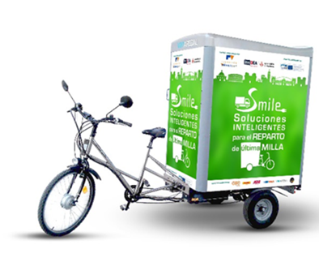
URBAN I - VPF AND SUSTAINABLE URBAN LOGISTICS. PROJECTS AND EXPERIENCES IN VALENCIA
UCC and electrically-assisted tricycles
The idea was to built an alternative system for last-mile distribution of parcels in urban areas adapted to the context.
  Promoting the use of a small vehicle more agile and more sustainable:
  e-tricycles: that do not have limitations for accessing the restricted areas
  Installing transhipment points, this facility can boost the participation of more transport operators. The transhipment terminal offers shelter and security for the transhipment, which also facilitates the work for the company managing the last mile delivery from the terminal.
SOLUTION AND IMPLEMENTATION
The GARBICYCLE model
An electrically assisted pedal tricycle designed and built in Euskadi (Spain)
Goods and parcels are transported in a closed container located on the back with a loading capacity of 1.5 m³
The dimensions are: (L) 2.78m x (W) 1.03m x (H) 1.95m
The total weight (unloaded) of 110kg with a maximum load of 280kg although the average weight of transport is 180kg (around 40 parcels)

Slide 12
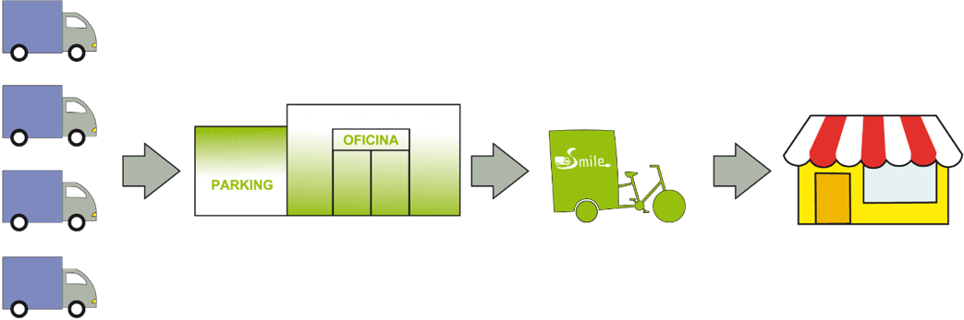

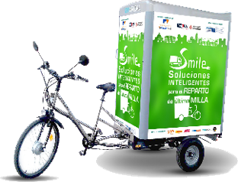
URBAN I - VPF AND SUSTAINABLE URBAN LOGISTICS. PROJECTS AND EXPERIENCES IN VALENCIA
UCC and electrically-assisted tricycles
The pilot on electric mobility in the city of Valencia was tested from the 8th October 2014 until 31th January.
The pilot was focused in the last mile delivery of parcels using electric tricycles in the city centre of Valencia and supported by the use of a micro-distribution platform that manages the interchange of goods.

Slide 13








URBAN I - VPF AND SUSTAINABLE URBAN LOGISTICS. PROJECTS AND EXPERIENCES IN VALENCIA
UCC and electrically-assisted tricycles
Eco-logistics company operator of Last-Mile deliveries
Parking facilities Manager
Research support, modelling & dissemination
City Council. Coordination, knowledge, permits, regulations
Transport operators involved. Companies that tested the services
ACTORS INVOLVED

Slide 14
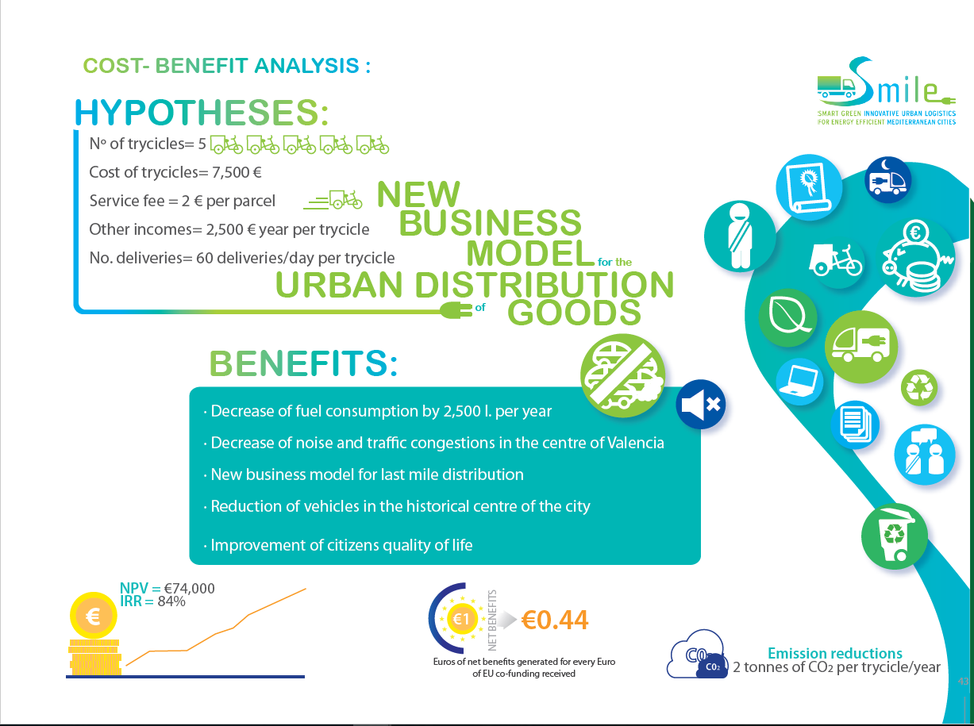
URBAN I - VPF AND SUSTAINABLE URBAN LOGISTICS. PROJECTS AND EXPERIENCES IN VALENCIA

Slide 15


URBAN I - VPF AND SUSTAINABLE URBAN LOGISTICS. PROJECTS AND EXPERIENCES IN VALENCIA
Key ideas
Consider the features of the implementing area: commercial area, vehicle access restrictions
Role and involvement of key stakeholders
Type of service: parcel size limitation
Routes optimization
Economic equilibrium
Challenges for implementation
The main challenge is to reach agreements with transport operators.
Manager of the transhipment terminal should be a neutral company that does not compete with the other operators.
The support of the city council is also crucial to obtain positive feedback
The location of the transhipment terminal: connected to the main access roads for accessing the delivery area, close to the destination
Visual perception of the transhipment terminal
Business model

Slide 16
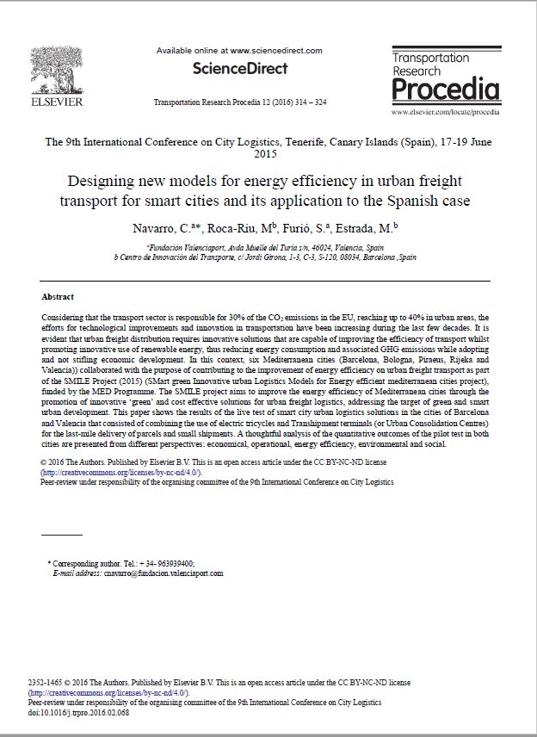
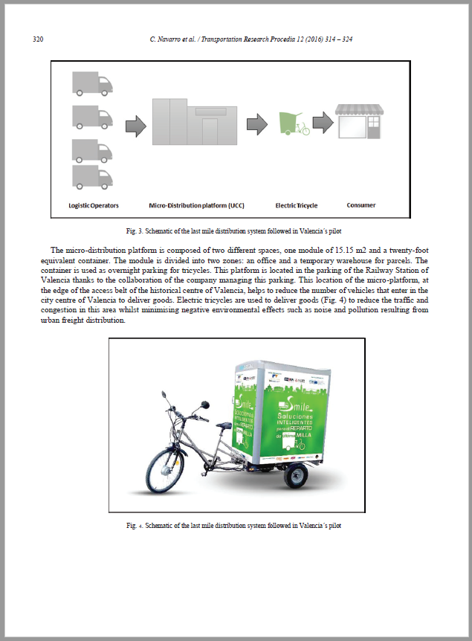
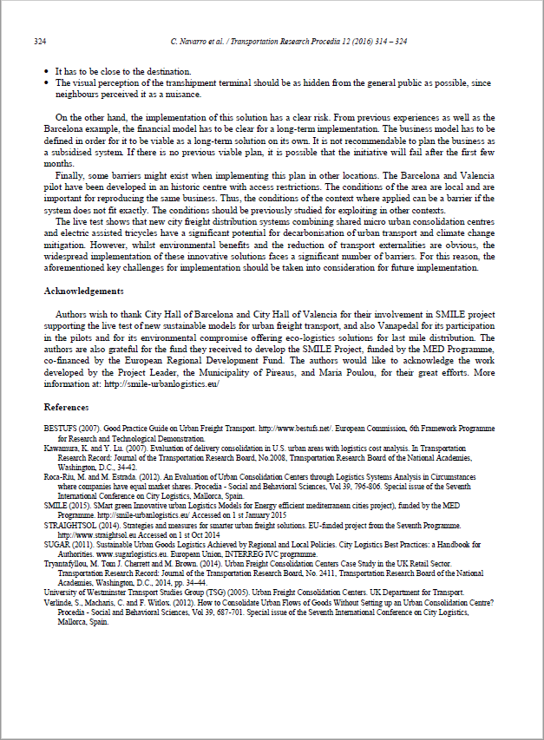
URBAN I - VPF AND SUSTAINABLE URBAN LOGISTICS. PROJECTS AND EXPERIENCES IN VALENCIA
SCIENTIFIC DISSEMINATION: PAPER

Slide 17

URBAN I - VPF AND SUSTAINABLE URBAN LOGISTICS. PROJECTS AND EXPERIENCES IN VALENCIA
Sustainable Urban Consolidation CentrES for conStruction

Slide 18










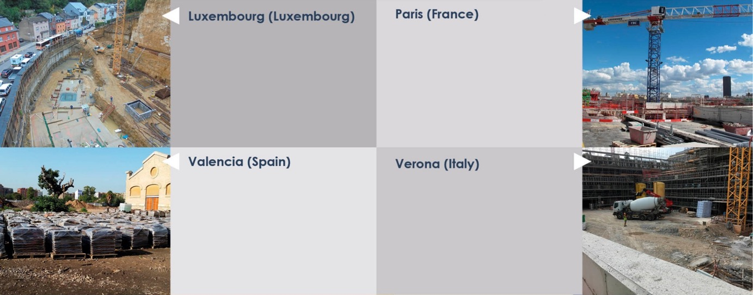
URBAN I - VPF AND SUSTAINABLE URBAN LOGISTICS. PROJECTS AND EXPERIENCES IN VALENCIA
The aim is to study the role that UCC (and other innovative solutions) can play to minimise the impact of freight transport and logistics related to construction activities in the cities (4 type of works and pilot cities, 11 partners)
Research Centres
Construction sector
Municipalites
11 400 m²
€21 M
Refurbishment and construction of apartments,
55 475 m²
€144 M
Refurbishment, conversion of two buildings into a single complex with offices
110 826 m²
€16 M
Urbanisation of a park
853 914 m²
126 M €
Extension and renovation of two hospitals

Slide 19
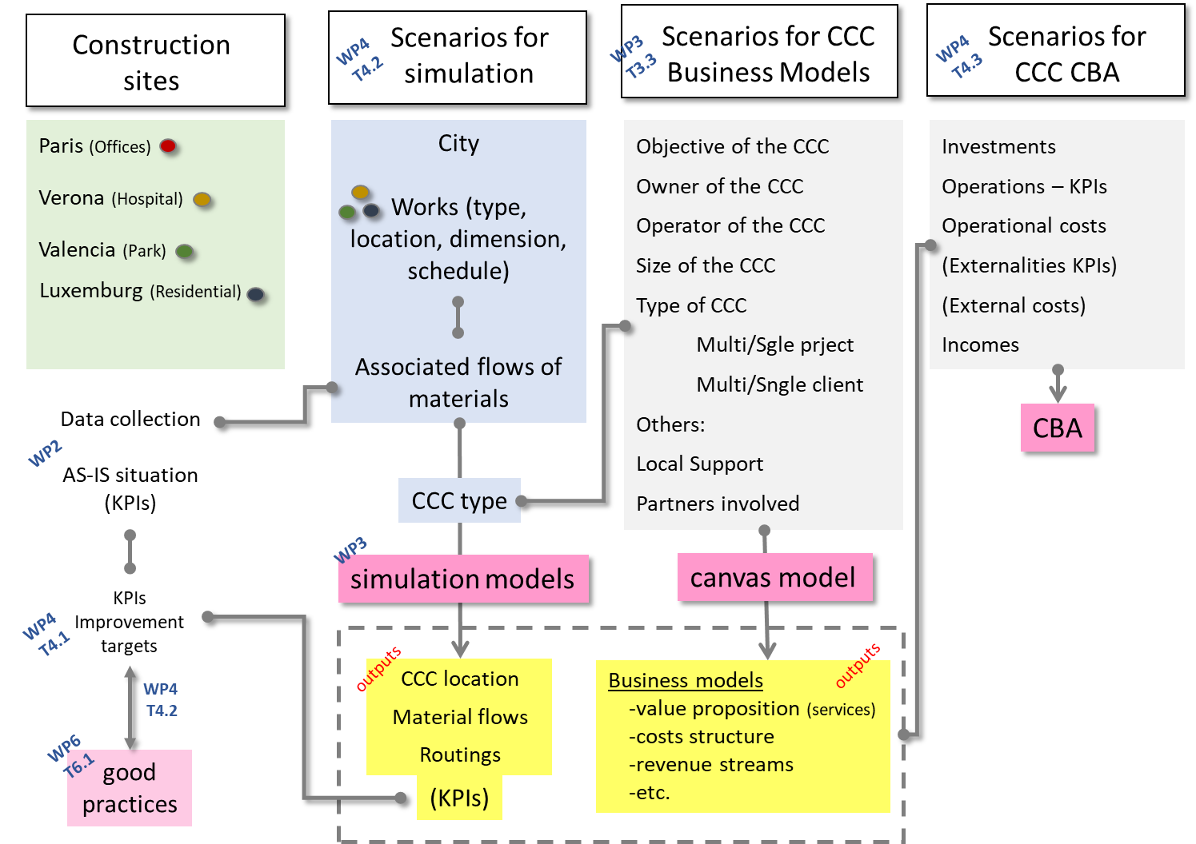
URBAN I - VPF AND SUSTAINABLE URBAN LOGISTICS. PROJECTS AND EXPERIENCES IN VALENCIA

Slide 20
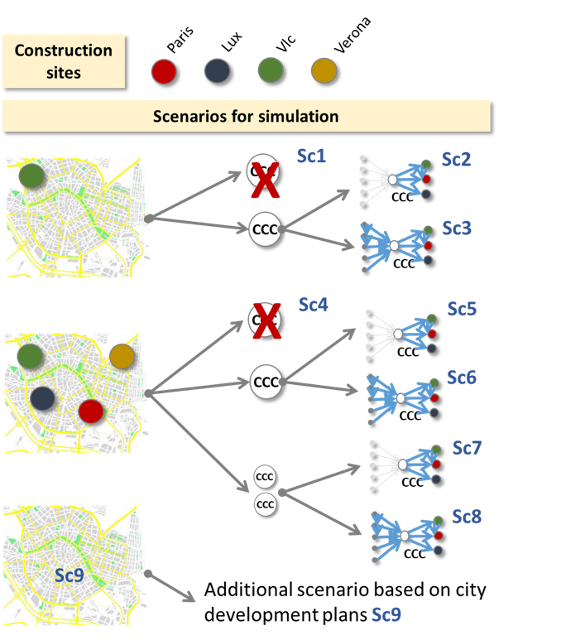
URBAN I - VPF AND SUSTAINABLE URBAN LOGISTICS. PROJECTS AND EXPERIENCES IN VALENCIA
Daily material requirements
Location of the suppliers
Location of site
Type of vehicles
…
Simulation models (transport and inventory problems)
Class 1: Facility Location, Location-allocation problems: 2E-FLPs
Class 2: Routing problems: 2E-VRPs
Class 3: Location-Routing Problems: 2E-LRPs
Location of CCCs
Optimisation of transport flows/ routes

Slide 21
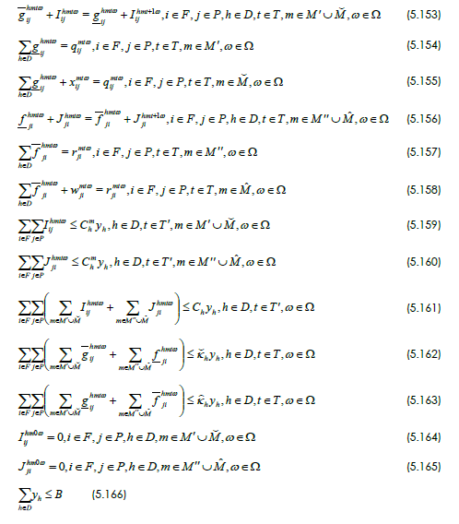
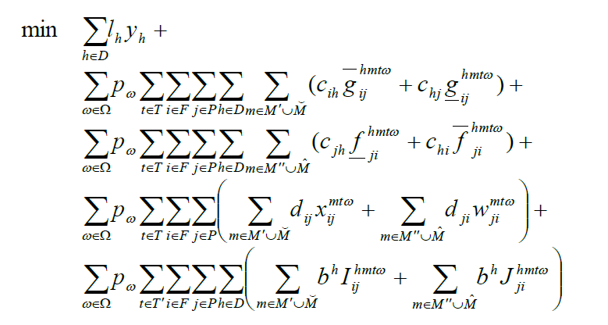
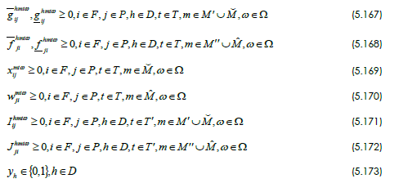
URBAN I - VPF AND SUSTAINABLE URBAN LOGISTICS. PROJECTS AND EXPERIENCES IN VALENCIA
Stochastic Multi Period Multi Material with Inventory, Reverse logistics and Direct shipping Model
cost of direct flow of materials from supplier to site passing through CCC
cost of reverse flow of materials passing through CCC
set-up cost of CCC
cost of direct and reverse flow of materials no passing through CCC
cost of inventories in CCC

Slide 22
URBAN I - VPF AND SUSTAINABLE URBAN LOGISTICS. PROJECTS AND EXPERIENCES IN VALENCIA
SUMPORT – Sustainable Urban Mobility in MED PORT cities

Slide 23
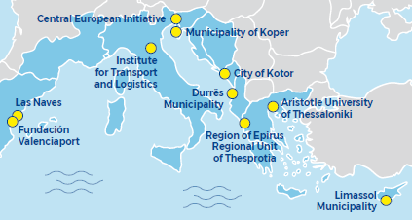




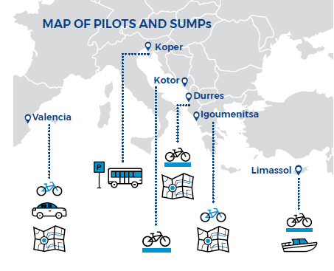


URBAN I - VPF AND SUSTAINABLE URBAN LOGISTICS. PROJECTS AND EXPERIENCES IN VALENCIA
The aim is to improve sustainable mobility in port cities through developing/improving Sustainable Urban Mobility Plans and piloting sustainable solutions.
(8 cities, 6 countries, 10 partners)
Extension or creation of bicycle lanes
Bike sharing
Simulation of maritime transport:sustainable multimodal smart mobility
Carpooling system for port workers
SUMP elaboration, update or harmonisation
Infomobility to promote public transport: parking lots and busses equipped with sensors

Slide 24
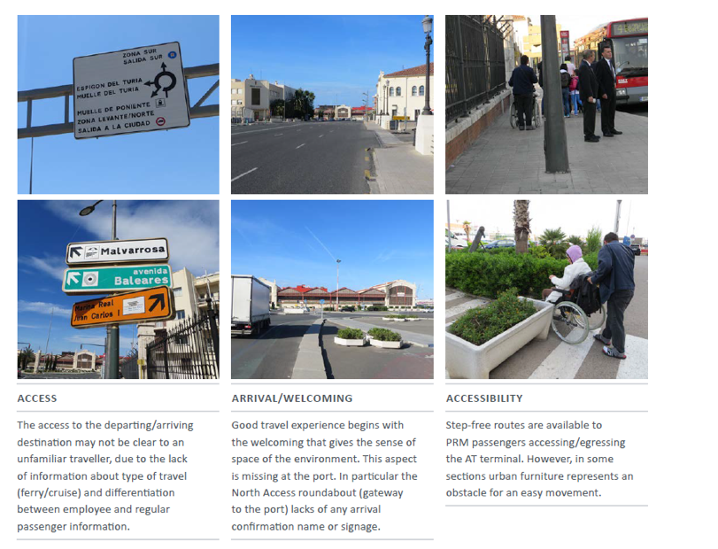
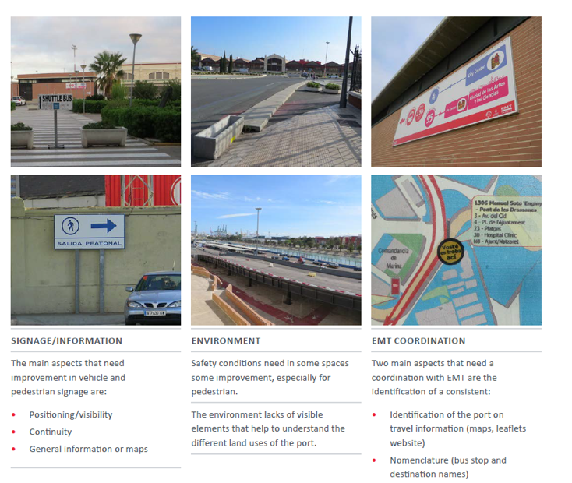
URBAN I - VPF AND SUSTAINABLE URBAN LOGISTICS. PROJECTS AND EXPERIENCES IN VALENCIA
Valencia - wayfinding diagnosis

Slide 25
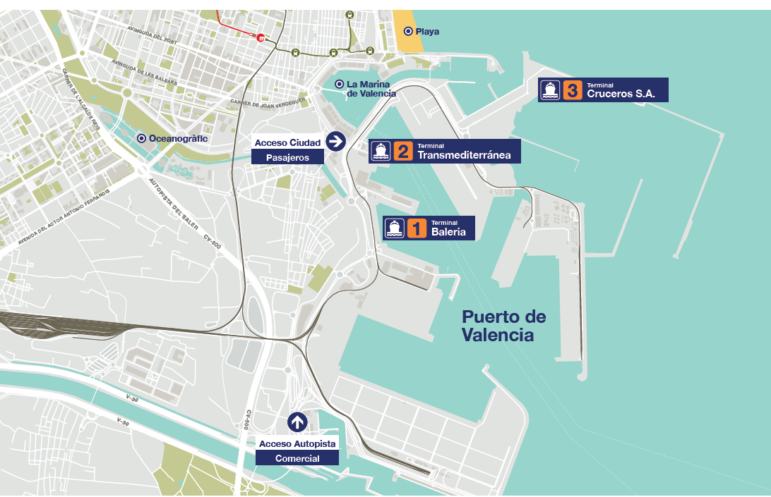
URBAN I - VPF AND SUSTAINABLE URBAN LOGISTICS. PROJECTS AND EXPERIENCES IN VALENCIA
Valencia - wayfinding strategy

Slide 26
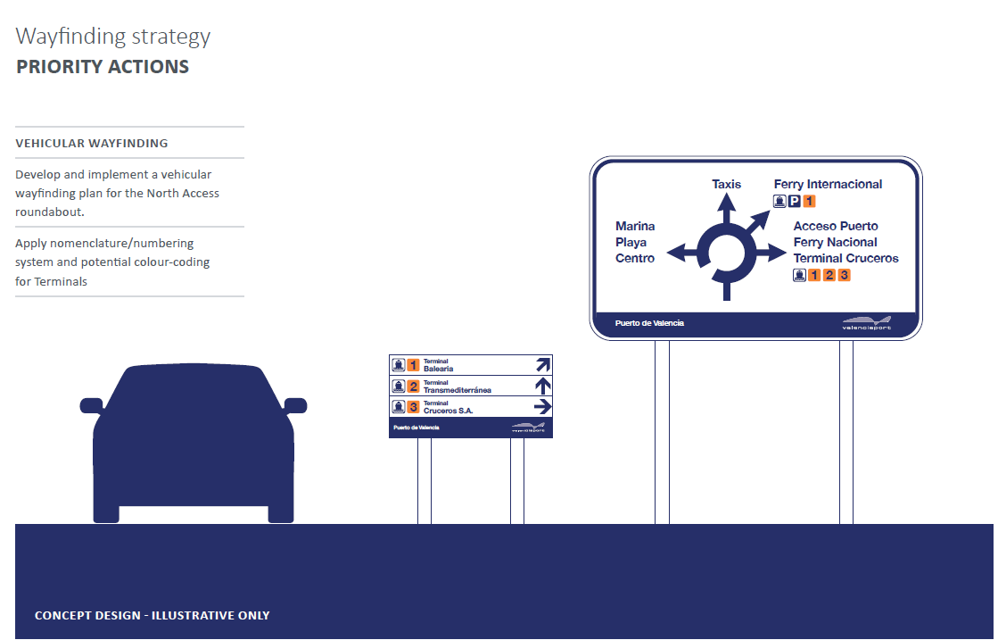
URBAN I - VPF AND SUSTAINABLE URBAN LOGISTICS. PROJECTS AND EXPERIENCES IN VALENCIA
Valencia - wayfinding strategy

Slide 27
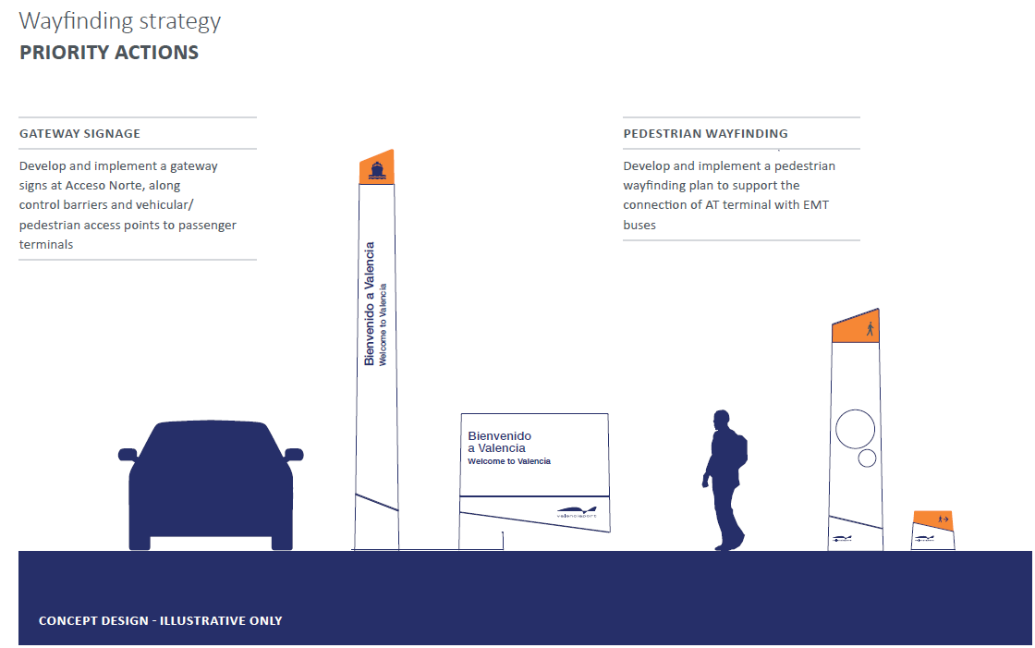
URBAN I - VPF AND SUSTAINABLE URBAN LOGISTICS. PROJECTS AND EXPERIENCES IN VALENCIA
Valencia - wayfinding strategy

Slide 28
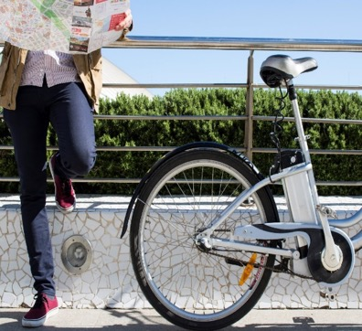
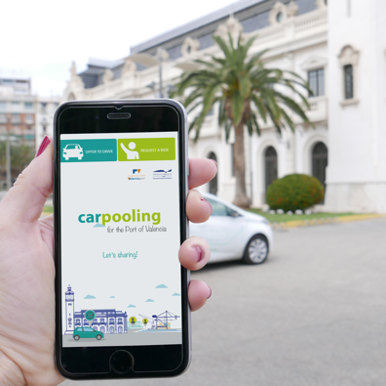
URBAN I - VPF AND SUSTAINABLE URBAN LOGISTICS. PROJECTS AND EXPERIENCES IN VALENCIA
Valencia - pilots
E-bikes sharing system
Valenciaport Foundation will set up and test a system of e-bike sharing within the port premises.
Such an innovative tool will allow wider environment-friendly mobility options in the port and in the city, decreasing pollution and emission of GHG and improving the quality of life of the citizens and of the working force of the port.
Carpooling system
Valenciaport Foundation will test a car pooling system in the port, allowing workers of the port to share their own cars, reducing the number of vehicles with only one person onboard. This system is particularly useful for destinations with a high number of daily commuters, such as the journey
home-workplace

Slide 29
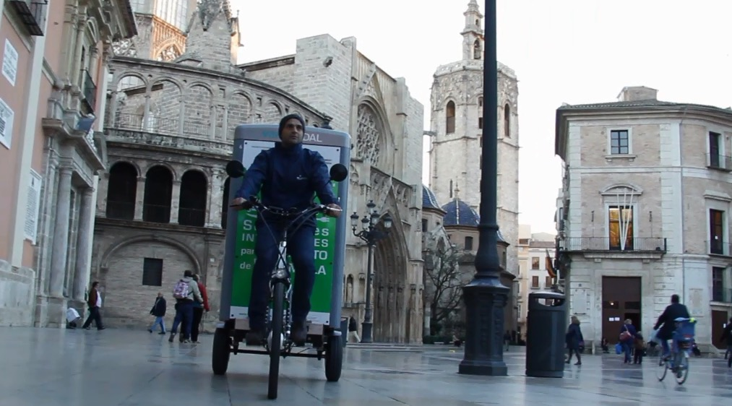
URBAN I - VPF AND SUSTAINABLE URBAN LOGISTICS. PROJECTS AND EXPERIENCES IN VALENCIA
Thanks for your attention

Slide 30
URBAN I
VPF AND SUSTAINABLE URBAN LOGISTICS. PROJECTS AND EXPERIENCES IN VALENCIA
Salvador Furió
(Fundación Valenciaport)

Slide 31
URBAN I - VPF AND SUSTAINABLE URBAN LOGISTICS. PROJECTS AND EXPERIENCES IN VALENCIA

