Slide 1
AN EXPLORATORY TWO-DIMENSIONAL APPROACH TO PORT CHOICE BEHAVIOR MODELING
VI Meeting on International Economics, IEI, University Jaume 1,
September 27-29, 2017, Villa-real, Spain
BI Park and SK Sung
School of Logistics and Commerce
Chonnam National University, KOREA

Slide 2
PRESENTATION OUTLINE
RESEARCH MOTIVATION
RESEARCH GOALS & METHODOLOGY
LITERATURE REVIEW
ASSUMPTIONS
KANO MODEL
EMPIRICAL TESTS
KANO ANALYSIS FINDINGS
IMPORTANCE SELECTION ANALYSIS
REVISED STRATEGIES FOR EACH PORT
CONCLUSIONS AND IMPLICATIONS

Slide 3
RESEARCH MOTIVATION(1/2)
Implicit assumptions of the factor characteristics
  Proportional relationship to port choice behavior
  Linear relations between factors and port choice behavior (see left graph)
  Beliefs: The larger, the better
    prefer a larger score on the Likert scale
Port
Choice
Behavior
Factors

Slide 4
RESEARCH MOTIVATION(2/2)
Possible forms of the port choice factors to behavior
  Linear
    Proportional (A)
    Reversal (B, wrong question) reverse calculation ⇒ Positive
  Nonlinear(Swan and Combs, 1976)
    Expressive (Attractive) (C)
    Instrumental (Must-be) (D)
  Indifferent (E)
C
Port
Choice
Behavior
A
E
D
B
Factors

Slide 5
RESEARCH GOALS
To identify the factor characteristic forms
  Linear
  Non-linear
To modify and develop the model
  With factor characteristics
  To improve Port Choice behavioral analysis
To revise strategies for each port
  Via a two-dimensional approach with an ISA tool

Slide 6
METHODOLOGY
Background theory
  Kano Model
    One of Service Quality Management Theories
      Kano, N., Seraku, N., & Takahashi, F.(1984), “Attractive quality and must-be quality,” The Journal of the Japanese Society for Quality Control, 14(2), 39-48 – written by Japanese
    Based on the Herzberg's Motivators - Hygienes Theory
  Applying to the Port Choice Behavior Modeling
Empirical study
  Pooling a factor set ← literature reviews and interviews
  Reducing the factor set ← pilot survey
  Analyzing factor characteristics ← main survey with Kano questionnaires
  Applying a ISA(IPA) approach to the survey results
  Research findings and implications

Slide 7
LITERATURE REVIEW(1/3)
Researches | Factors | Types of port | Methodologies
Murphy et al.(1992) | Cargo damage, infra | Gate | Importance ranking
Malchow and Kanafani(2001) | Distance, frequency | Gate | MNL Logit
Lirn et al.(2003) | Location, charges, infra | TS | Delphi, AHP
Veldman and Bükmann(2003) | Transit time, location cost, frequency, intermodality | Gate | MNL Logit
Malchow and Kanafani(2004) | Distance, frequency | Gate | MNL Logit, Chamberlain model
Lirn et al.(2004) | Location, charges, infra | TS | AHP
Tai and Hwang(2005) | Location cost, location, efficiency, frequency, charges, infra | TS | Gray decision model
Guy and Urli(2006) | Location, charges, infra | TS | MCDM
Ng(2006) | Location, efficiency, reputation, cargo damage, charges, infra | TS | Average scores, t-test
Acosta et al.(2007) | Efficiency, intermodality, infra
Tongzon and Sawant(2007) | Location, efficiency, charges, infra | Gate | Binary Logit
Chang et al.(2008) | Location, reputation, intermodality, charges, infra | Gate | Mean value, t-test, EFA, CFA

Slide 8
LITERATURE REVIEW(2/3)
Researches | Factors | Types of port | Methodologies
Wiegmans et al.(2008) | Location, efficiency, reputation, intermodality, charges, infra | Gate/TS | Importance ranking
Yeo et al.(2008) | Distance, location cost, congestion, quick response to customers’ needs, intermodality, infra | Gate/TS | EFA
Anderson et al.(2009) | Distance, transit time, location cost | Gate | Nested Logit
Tongzon (2009) | Location, efficiency, cargo damage, quick response to customers’ needs, frequency, charges, infra |  | Regression
Chou (2010) | Location cost, efficiency, frequency, intermodality, charges, infra | Gate/TS | AHP
Caillaux et al.(2011) | Transit time, cost, efficiency, charges | TS | Ordinal Copeland method, DEA
Park and Min(2011) | Location, charges, infra | TS | Hybrid DEA/AHP
Yeo et al.(2011) | Distance, location cost, congestion, quick response to customers’ needs, intermodality, infra |  | Fuzzy AHP
Tang et al.(2011) | Efficiency, frequency, intermodality, charges, infra | Gate/TS | NICE

Slide 9
LITERATURE REVIEW(3/3)
Researches | Factors | Types of port | Methodologies
Yuen at al.(2012) | Location, efficiency, frequency, intermodality, charges, infra | Gate/TS | AHP
Da Cruz et al.(2013) | Location, efficiency, intermodality, infra | Gate/TS | AHP
Ng et al.(2013) | Distance, cost, efficiency, charges | Gate | Importance ranking
Source: Martinez and Feo (2016) and author own categorization Note: Other minor factors are excluded.
All the research is probably based on the implicit assumption
  proportional relationship of factors to port choice behavior
No(?) existed researches which dealt with the characteristics form of factors
Notes:
This table was adapted from Maria’s paper.

Slide 10
ASSUMPTIONS
The port users select ports by the preference recognitions or perceptions to serval related factors of their own
Port choice factors are multi-dimensional to choice behavior
  Proportional form
  Factors affecting selection behavior only above a certain level(Attractive or excitement)
  Minimum requirements(Must-be)
  Indifferent
⇒ Need to construct a port choice behavior structure reflecting each factor characteristics

Slide 11
KANO MODEL
Developed by Kano, Noriaki et al.(1984)
  Two-dimensional service-quality modeling
    Kano, N., Seraku, N., and Takahashi, F. (1984), “Attractive quality and must-be quality,” The Journal of the Japanese Society for Quality Control, 14(2), 39-48. – Written by Japanese
  Based on the idea of Herzberg’s Motivators - Hyiegnes Theory
Assumption
  The existence of nonlinear and asymmetric relationships
  Between the attribute-level performance of service factors and overall customer satisfaction (OCS)
  The model consider the order of impact: M>O>A>I

Slide 12
KANO MODEL(SELECTION)
Subjective aspect
Excitement
Objective aspect
No Satisfaction
No Dissatisfaction
Basic

Slide 13
Factor Categories in Kano Model
Characteristics | Definition | Recommendations
Attractive (Satisfiers) -Excitement | An Attractive attribute leads to a better satisfaction, whereas its absence does not increase dissatisfaction | Include a good number of Attractive attributes
One-dimensional (Criticals) | A One-dimensional attribute fulfillment helps enhance the satisfaction and vice versa. | Include a good number of One-dimensional
Must-be (Dissatisfiers) -Basic | A Must-be attribute absence produces absolute dissatisfaction and its presence does not increase satisfaction | Continue Must-be attributes
Indifferent (Neutrals) | An Indifferent attribute, that result neither in satisfaction nor dissatisfaction, whether fulfilled or not | Avoid Indifferent attributes as many as possible
Reverse | A Reverse attribute presence causes dissatisfaction and its absence causes satisfaction | Avoid Reverse attributes
( ) : Cadotte, E. and Turgeon, N.(1988), “Dissatisfiers and Satisfiers : Suggestions from Consumer Complaints and Compliments,” Journal of Consumer Satisfaction, Dissatisfaction, and Complaining Behavior, 1, 74-79.

Slide 14
Structure of Kano Questionnaires
Positive Question
Negative Question

Slide 15
Kano Evaluation

Slide 16
Model Weakness
The Kano model
  Categorizes the quality attributes by the number of frequencies of respondents’ answers
  Ignores the difference between with relatively multiple characteristic factors and single prominent characteristic factor
Attribute | Attract. | One-dim. | Must-be | Indiff. | Forms
SF01 | 7 | 9 | 10 | 13 | Indiff.
SF02 | 3 | 20 | 3 | 14 | One-dim.
SF03 | 1 | 14 | 13 | 3 | One-dim.
SF04 | 6 | 17 | 7 | 10 | One-dim.
SF05 | 5 | 13 | 5 | 17 | Indiff.
SF06 | 8 | 18 | 5 | 9 | One-dim.

Slide 17
Customer Satisfaction Coefficient
(CS-Coefficient: Berger et al., 1993)
Indicative of how strongly a product feature may influence satisfaction or, in case of its ”non-fulfillment” customer dissatisfaction
Extent of satisfaction: (A+O)/(A+O+M+I)
Extent of dissatisfaction: (O+M)/(A+O+M+I) x (-1)
  A minus sign is put in front of the CS-coefficient of customer dissatisfaction to emphasize its negative influence on customer satisfaction if this quality is not fulfilled
Berger, C. et al. (1993), “Kano’s methods for understanding customer-defined quality,” Center for Quality of Management Journal, 2(4), 2-36.

Slide 18
EMPRRITICAL TESTS
Pool of Factors
Pilot Survey
Main Survey
Importance Selection Analysis (or IPA)

Slide 19
Pool of Port Choice Factors
Attributes
Traffic Volume and Throughput
Containerized Cargo Proportion
Geographical merit
Major Container Center
Frequencies of feeder vessels
Variety of Service Routes
Competitiveness and Diversity of Other Modes
Deviation from Trunk Routes
Short Transit Time
Proximity to Alternative Port
Intermodal Links and Network Accessibility
Frequency of Trunk Routes
Depth of the port
Size of Port and terminal
Infra and Superstructure of Port
Port Information System
Cost for Inland Transportation
Attributes
Port Service Coverage
Economic Size of Local and Regional Market Niche
Vessel Berthing Capacity of Port
Sufficiency and Quality of Port Equipment
Cargo Handling System Support
State-Aided and Influence on Cost
Cost for Terminal Handling and Storage
Free Dwell Time
Related Business Operation
Privileged Ownership Contract to Carrier
Balance of Inbound and Outbound Cargo
Calling of Alliance Members
Calling of Competitors
Port Dues
Port Incentive Scheme
National Stability (Politics, Society, Labor, etc.)
Attributes
Port Tradition and Organization
Quality of Customs Handling
Port Authority Policy and Regulations
Container Handling Efficiency
Flexible Operation Process
Reliability of Cargo Handling
Port Marketing
Length of Port Berthing Time
Port Productivity
Port Safety and Security
Recognition and Reputation of Port
Prompt Response to Claim and Request
Supporting Services
Cargo Handling Safety
Speedy Cargo Handling
Quality and Availability of Staff
Yun and Park(2017)

Slide 20
Pilot Survey
Pilot Survey (2017.05.12~19)
distributed | corrected | Effective
30 | 25 | 25
Condensed the Dataset by the Average Scores
No. | Factor | No. | Factor | No. | Factor | No. | Factor
SF01 | Traffic Volume and Throughput | SF04 | Depth of the Port | SF07 | Cost for Terminal Handling and Storage | SF10 | Reliability of Cargo Handling
SF02 | Variety of Service Routes | SF05 | Size of Port and Terminal | SF08 | Port Dues | SF11 | Speedy Cargo Handling
SF03 | Intermodal Links and Network Accessibility | SF06 | Sufficiency and Quality of Port Equipment | SF09 | Cost for Inland Transportation | SF12 | Quality and Availability of Staff
Yun and Park (2017)

Slide 21
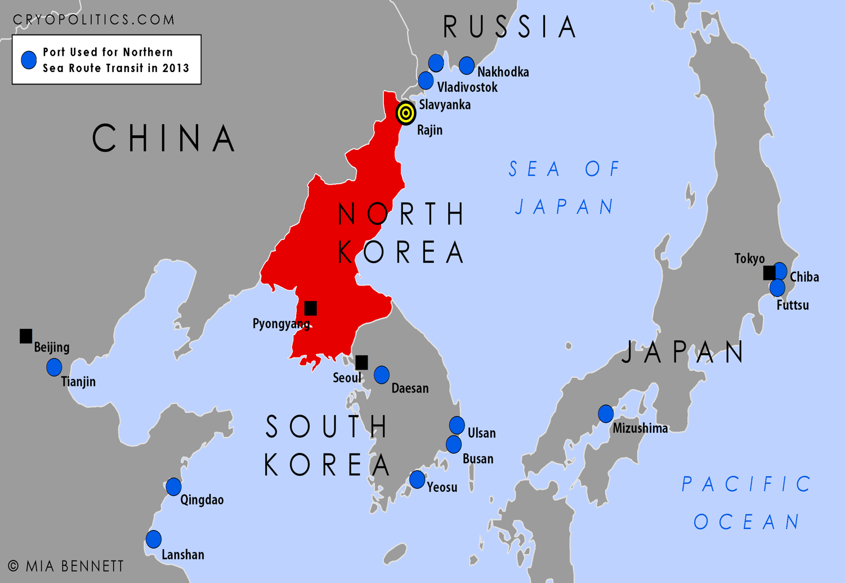
 | Throughput(,000 teus) |  | Lloyd’s World port ranking (2015)
 | 2015 | 2016
Busan | 19,469 | 19,456 | 6
Incheon | 2,377 | 2,680 | 67
Gwangyang | 2,327 | 2,250 | 68
Incheon
Gwangyang

Slide 22
Main Survey
Demographical Statistics
PAs* | Collected | OCs* | Collected | Carriers | Collected
YGPA | 5 | Gwangyang | 5 |  | 23
BPA | 5 | Busan | 5
IPA | 5 | Incheon | 5
Sub total | 15 | Sub total | 15
Survey period: 22/05/2017-09/06/2017 Sampling techniques: * stratified sampling Questionnaire collection: email and in-depth interview

Slide 23
Main Survey Analysis : Total (1/4)
Factor | Original Kano Model |  |  |  |  |  | CS-Coeff. Berger et al.(1993)
 | Attract. | One-dim. | Must-be | Indiff. | Reversal | Forms | Satis. Coeff. | Dissatis. Coeff. | Forms
SF01 | 7 | 9 | 10 | 13 | 1 | Indiff. | 0.4103 | -0.5897 | Indiff.
SF02 | 3 | 20 | 3 | 14 | 0 | One-dim. | 0.5750 | -0.4250 | One-dim.
SF03 | 1 | 16 | 9 | 13 | 1 | One-dim. | 0.4359 | -0.5641 | Must-be
SF04 | 6 | 17 | 7 | 10 | 0 | One-dim. | 0.5750 | -0.4250 | One-dim.
SF05 | 5 | 13 | 5 | 17 | 0 | Indiff. | 0.4500 | -0.5500 | Indiff.
SF06 | 8 | 18 | 5 | 9 | 0 | One-dim. | 0.6500 | -0.3500 | One-dim.
SF07 | 3 | 22 | 6 | 9 | 0 | One-dim. | 0.6250 | -0.3750 | One-dim.
SF08 | 2 | 20 | 4 | 14 | 0 | One-dim. | 0.5500 | -0.4500 | One-dim.
SF09 | 2 | 20 | 7 | 10 | 1 | One-dim. | 0.5641 | -0.4359 | One-dim.
SF10 | 2 | 19 | 8 | 11 | 0 | One-dim. | 0.5250 | -0.4750 | One-dim.
SF11 | 5 | 23 | 8 | 4 | 0 | One-dim. | 0.7000 | -0.3000 | One-dim.
SF12 | 4 | 18 | 7 | 11 | 0 | One-dim. | 0.5500 | -0.4500 | One-dim.

Slide 24
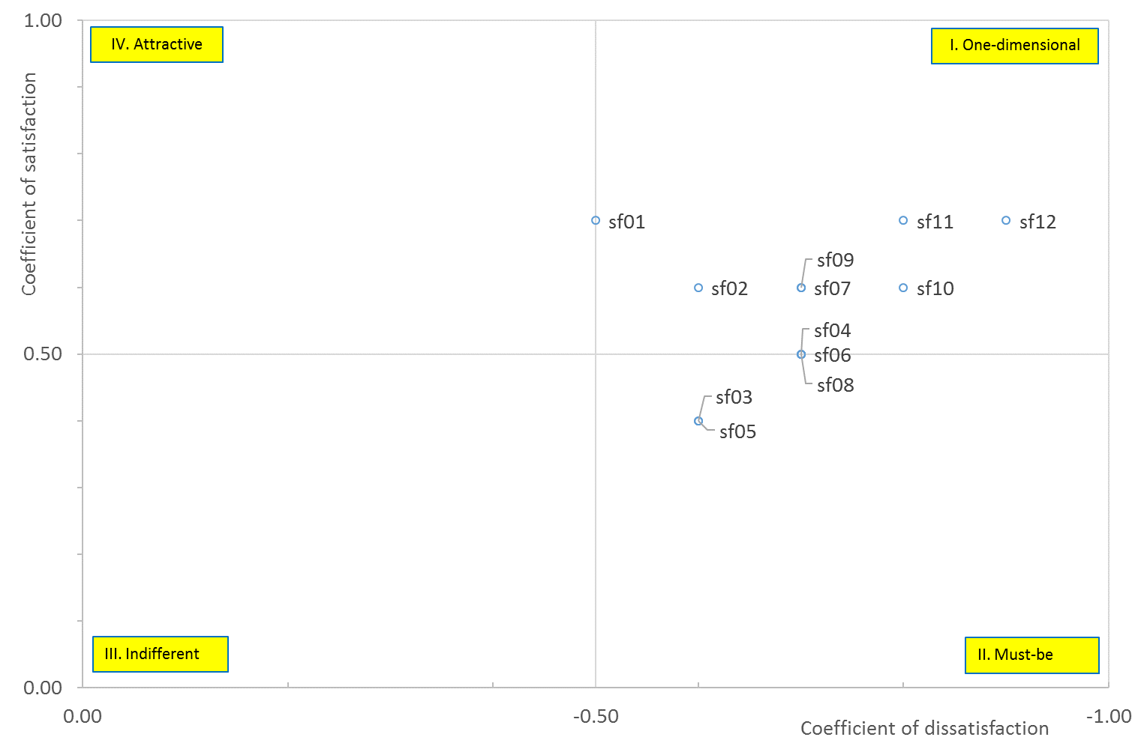
Main Survey Analysis: Carriers (2/4)

Slide 25
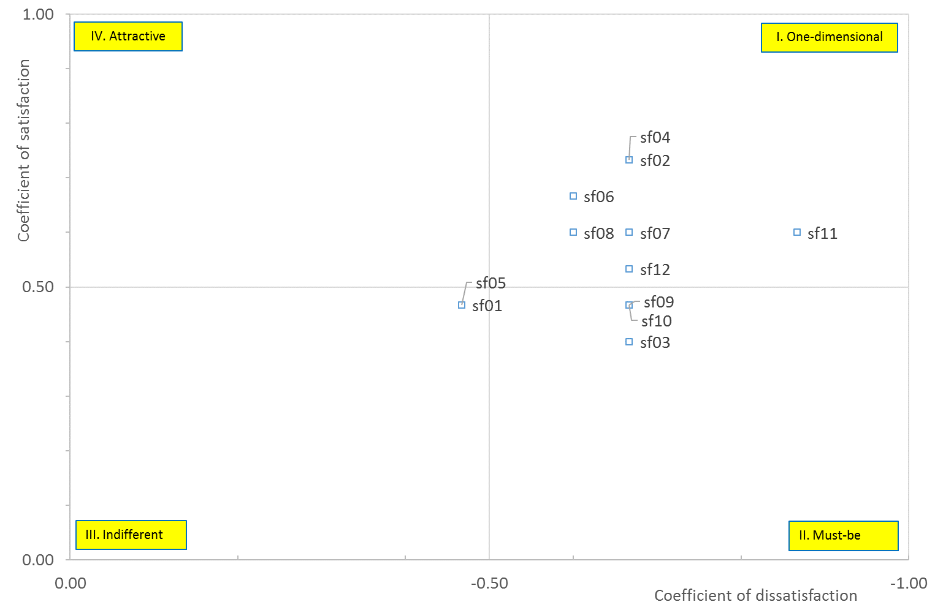
Main Survey Analysis : PAs (3/4)

Slide 26
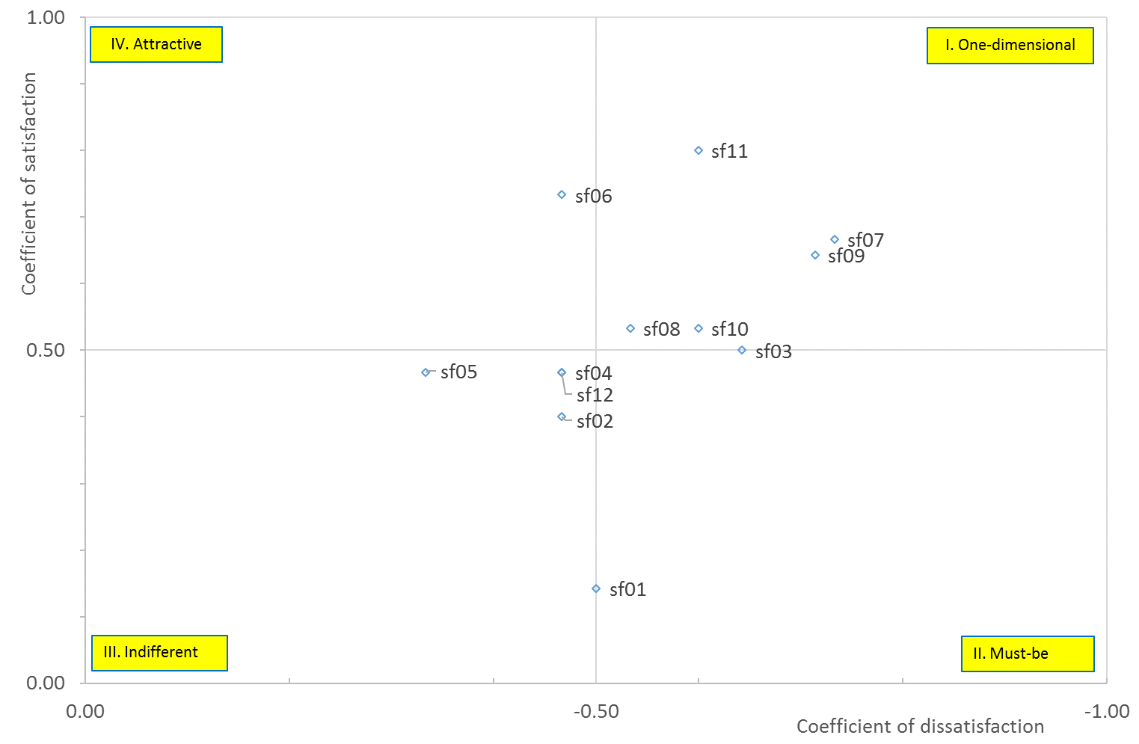
Main Survey Analysis : OCs (4/4)

Slide 27
RESULTS OF THE ANALYSIS
Characteristics | Total | Carriers |  | Suppliers | PAs | OCs
Attractive |  |  |  |  |  | SF06
 |  | SF01 | Traffic Volume and Throughput
One-dimensional
 | SF02 SF04 SF06 SF07 SF08 SF09 SF10 SF11 SF12 | SF02 SF07 SF09 SF10 SF11 SF12 | Variety of Service Routes Cost for Terminal Handling and Storage Cost for Inland Transportation Reliability of Cargo Handling Speedy Cargo Handling Quality and Availability of Staff | SF02 SF04 SF06 SF07 SF08 SF09 SF11 | SF02 SF04 SF06 SF07 SF08 SF11 SF12 | SF07 SF08 SF09 SF10 SF11
 |  | SF04 SF06 SF08 | Depth of the Port Sufficiency and Quality of Port Equipment Port Dues | SF10 SF12 |  | SF03
Must-be
 | SF03 | SF03 SF05 | Intermodal Links and Network Accessibility Size of Port and Terminal | SF03 | SF03 SF09 SF10
 |  |  |  |  |  | SF01
Indifferent
 | SF01 SF05 |  |  | SF01 SF05 | SF01 SF05 | SF02 SF04 SF05 SF12

Slide 28
KANO ANALYSIS FINDINGS
There may be some factors which contradict the implicit assumption that port selection factors are proportional to port choice behavior
The characteristics of the port selection attributes are different from each stakeholder
  Characteristics of port selection attributes differ
    between users (carriers) and service providers (port authorities and operating companies)
    Factors that have same characteristics between service users and providers
      Must-be(SF03), One-dimensional (SF01, SF07)
    Possible problems that mismatch characteristics between service users and providers
      Problems of establishing and implementing Marketing Strategy
      Possibility of unnecessary effort of service provider that does not reflect user characteristics
  Within two service providers such as PAs and OCs, the characteristics of each port selection attribute differ from their roles
    The conflict in the factor characteristics between the governors of port facilities (PAs) and the operators (OCs) may evoke some problems
      Inefficiency of implementing port policies
      Inefficiency in port management
      Inefficient usage of social welfare

Slide 29
STRATEGIES BUILDING FOR PORTS
Criteria Importance (AHP)
No | Factor | Carriers | PAs | OCs
SF01 | Traffic Volume and Throughput | 0.1573 | 0.1386 | 0.1906
SF02 | Variety of Service Routes | 0.1058 | 0.2170 | 0.1326
SF03 | Intermodal Links and Network Accessibility | 0.0751 | 0.1024 | 0.1449
SF04 | Depth of the Port | 0.0361 | 0.0257 | 0.0278
SF05 | Size of Port and Terminal | 0.0719 | 0.0552 | 0.0286
SF06 | Sufficiency and Quality of Port Equipment | 0.0531 | 0.0281 | 0.0232
SF07 | Cost for Terminal Handling and Storage | 0.2012 | 0.1278 | 0.1554
SF08 | Port Dues | 0.0612 | 0.0440 | 0.0466
SF09 | Cost for Inland Transportation | 0.0643 | 0.1212 | 0.1095
SF10 | Reliability of Cargo Handling | 0.0556 | 0.0667 | 0.0459
SF11 | Speedy Cargo Handling | 0.0810 | 0.0513 | 0.0604
SF12 | Quality and Availability of Staff | 0.0373 | 0.0220 | 0.0344

Slide 30
STRATEGIES BUILDING FOR PORTS
Carriers’ Selection Intention for Each Port (Likert 5 scale)
No | Factor | Busan | Incheon | Gwangyang
SF01 | Traffic Volume and Throughput | 4.6522 | 3.4783 | 3.0435
SF02 | Variety of Service Routes | 4.8696 | 2.8696 | 3.0000
SF03 | Intermodal Links and Network Accessibility | 4.3913 | 3.5217 | 3.3478
SF04 | Depth of the Port | 4.3043 | 3.0435 | 4.0000
SF05 | Size of Port and Terminal | 4.6522 | 3.3043 | 3.8261
SF06 | Sufficiency and Quality of Port Equipment | 4.3913 | 3.3043 | 3.5652
SF07 | Cost for Terminal Handling and Storage | 3.6522 | 3.1304 | 4.0435
SF08 | Port Dues | 3.7391 | 3.2609 | 4.1304
SF09 | Cost for Inland Transportation | 3.7826 | 3.1739 | 3.4783
SF10 | Reliability of Cargo Handling | 4.5217 | 3.5217 | 3.9565
SF11 | Speedy Cargo Handling | 4.3478 | 3.2609 | 3.3913
SF12 | Quality and Availability of Staff | 4.3913 | 3.6522 | 3.7391

Slide 31
STRATEGIES BUILDING FOR PORTS
PAs’ Selection Perception for Each Port(Likert 5 scale)
No | Factor | Busan | Incheon | Gwangyang
SF01 | Traffic Volume and Throughput | 4.9333 | 3.5333 | 2.9333
SF02 | Variety of Service Routes | 5.0000 | 3.0000 | 2.8000
SF03 | Intermodal Links and Network Accessibility | 4.1333 | 4.4000 | 2.9333
SF04 | Depth of the Port | 4.6667 | 2.8667 | 4.4000
SF05 | Size of Port and Terminal | 4.9333 | 3.4000 | 3.8000
SF06 | Sufficiency and Quality of Port Equipment | 4.7333 | 3.2667 | 3.6000
SF07 | Cost for Terminal Handling and Storage | 4.0667 | 3.4000 | 4.1333
SF08 | Port Dues | 4.0000 | 3.5333 | 4.2667
SF09 | Cost for Inland Transportation | 3.7333 | 4.4000 | 3.2000
SF10 | Reliability of Cargo Handling | 4.8000 | 3.8000 | 3.7333
SF11 | Speedy Cargo Handling | 4.5333 | 3.4667 | 3.8667
SF12 | Quality and Availability of Staff | 4.4000 | 3.6000 | 3.7333

Slide 32
STRATEGIES BUILDING FOR PORTS
OCs’ Selection Perception for Each Port(Likert 5 scale)
No | Factor | Busan | Incheon | Gwangyang
SF01 | Traffic Volume and Throughput | 4.8000 | 3.4667 | 3.0667
SF02 | Variety of Service Routes | 4.8000 | 3.4667 | 2.8667
SF03 | Intermodal Links and Network Accessibility | 4.4000 | 3.8667 | 3.0667
SF04 | Depth of the Port | 4.7333 | 3.3333 | 3.7333
SF05 | Size of Port and Terminal | 4.7333 | 3.3333 | 3.6000
SF06 | Sufficiency and Quality of Port Equipment | 4.8000 | 3.4667 | 3.8667
SF07 | Cost for Terminal Handling and Storage | 3.7333 | 3.2000 | 3.8667
SF08 | Port Dues | 3.8000 | 3.5333 | 3.5333
SF09 | Cost for Inland Transportation | 3.6000 | 3.8667 | 3.2667
SF10 | Reliability of Cargo Handling | 4.4000 | 3.9333 | 4.0000
SF11 | Speedy Cargo Handling | 4.4000 | 3.6667 | 3.9333
SF12 | Quality and Availability of Staff | 4.5333 | 3.7333 | 3.7333

Slide 33
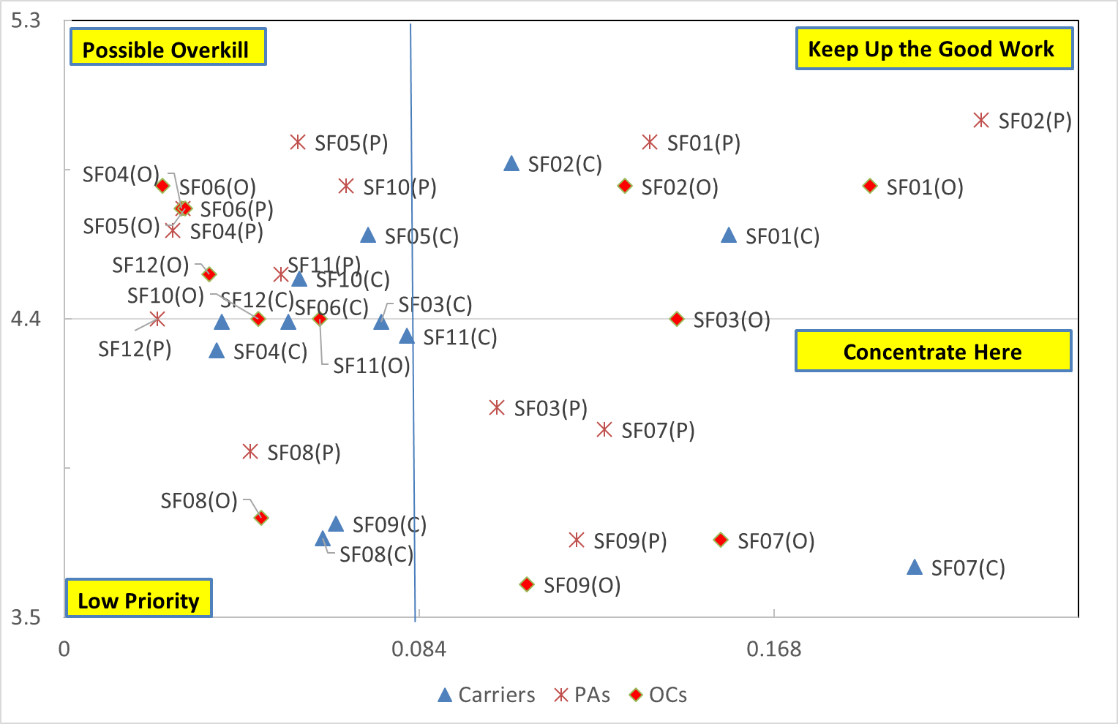
IMPORTANCE SELECTION ANALYSIS (Busan)
(IPA, Importance-Performance Analysis)

Slide 34
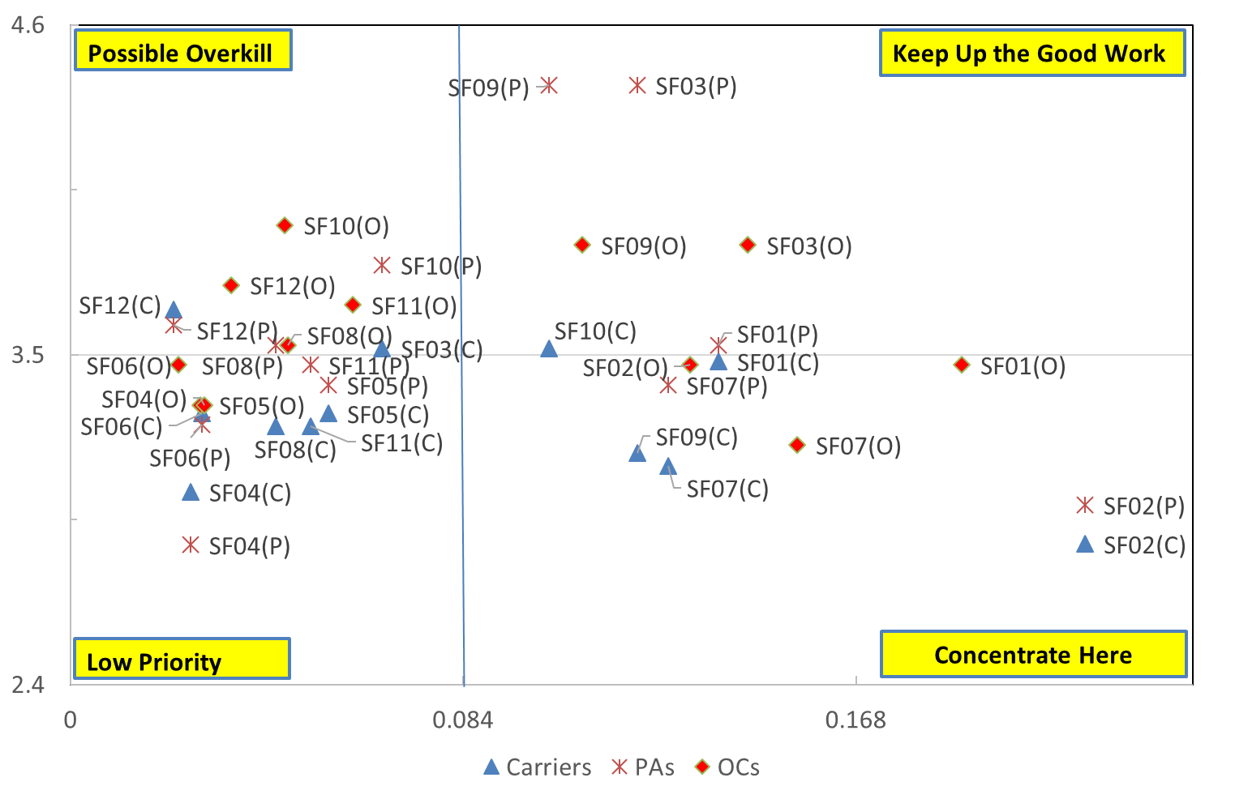
IMPORTANCE SELECTION ANALYSIS (Incheon)

Slide 35
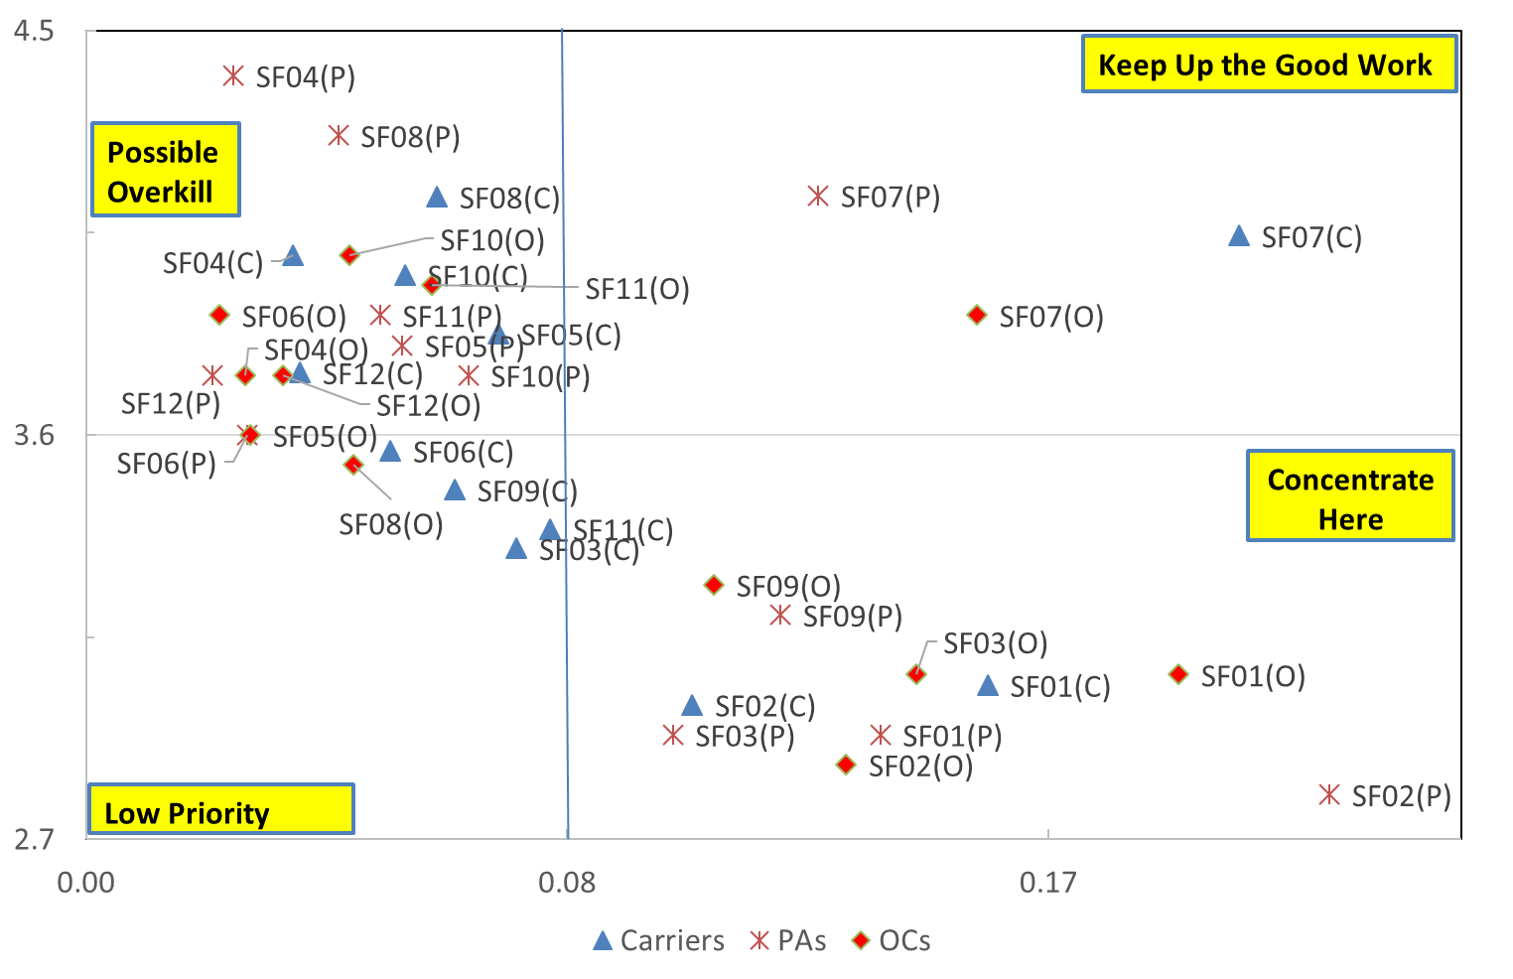
IMPORTANCE SELECTION ANALYSIS (Gwangyang)

Slide 36
REVISED STRATEGIES for EACH CONTAINER PORT
KANO | Factor | Busan |  |  | Incheon |  |  | Gwangyang
 |  | Carriers | PAs | OCs | Carriers | PAs | OCs | Carriers | PAs | OCs
A_O | SF01 | K | K | K | C | K | C | C | C | C
One D. | SF02 | K | K | K | C | C | C | C | C | C
M-B | SF03 | P_L | C | C_K | P | K | K | L | C | C
O_M | SF04 | L | P | P | L | L | L | P | P | P
M-B | SF05 | P | P | P | L | L | L | P | P | P_L
O_M | SF06 | L | P | P | L | L | L | L | P_L | P
One D. | SF07 | C | C | C | C | C | C | K | K | K
O_M | SF08 | L | L | L | L | P | P | P | P | L
One D. | SF09 | L | C | C | C | K | K | L | C | C
One D. | SF10 | P | P | P | K | P | P | P | P | P
One D. | SF11 | L | P | P_L | L | L | P | L | P | P
One D. | SF12 | L | P_L | P | P | P | P | P | P | P
A_O: Attractive and One Dimensional, One D.: One Dimensional, M-B: Must-Be, O_M: One Dimensional and Must-Be
C: Concentrate Here, K: Keep Up the Good Work , P: Possible Overkill, L: Low Priority

Slide 37
CONCLUSIONS AND IMPLICATIONS
The construction of port selection model should be revised
  Linear and nonlinear factors are reflected separately
  Factors of minimum requirement and excitement, also
Service strategies of service providers (PAs, OCs) also need to be modified
  The service providers (PAs, OCs) reduce the gaps in importance and characteristics of port selection factors to service users (carriers)
  Port operation and management strategy based on user needs is required
  Essential to establish policies for the operational efficiency of port management and policymakers (PAs) and satisfaction for port users(Carriers)

Slide 38
FUTURE STUDY
Just an exploratory study
Generalization (Reliability and validity by in-depth studies)
  Domestic
  Global
Methodological limitations
  Categorization problem of factors or criteria
  Berger at al.(1993), the coefficient is 0.5 ⇒ borderline problem ⇒which quadrant?
  Martilla and James(1977), IPA(ISA) ⇒ borderline problem
Next steps research
  How to use the results to construct the model?
  PLS-SEM and ISA
  ⇒ Building a detailed Port Choice Model considering the factor characteristic forms

Slide 39
THANK YOU FOR LISTENING
Prof. Dr. Byung In “BI” Park
bipark@chonnam.ac.kr
Dr. Souk Kyung “SK” Sung
ssky6261@gmail.com
School of Logistics and Commerce
Chonnam National University

Slide 40


